Slide 1






Slide 2


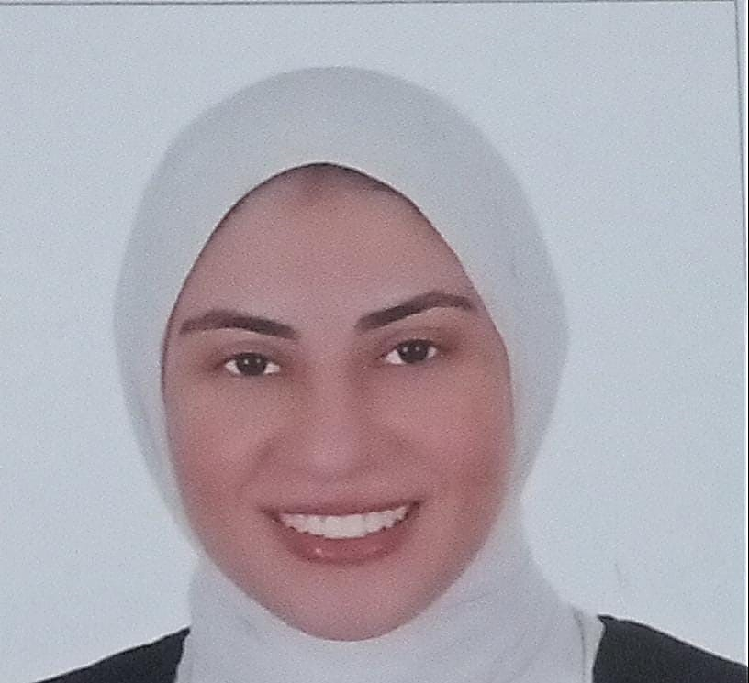
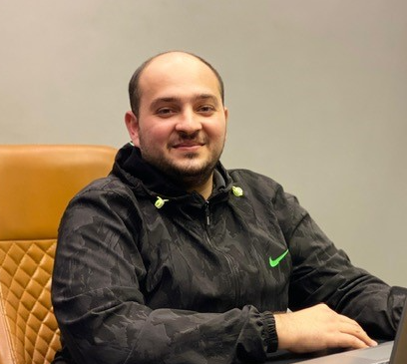

Project Team Members
Arwa Nagy
Ahmed Soudi
Amira Nasr
Osama Fouad
Doaa Saleh

Slide 3
Project Team Members
Arwa Nagy
Ahmed Soudi
Amira Nasr
Osama Fouad
Doaa Saleh

Slide 4
Project Team Members
Arwa Nagy
Ahmed Soudi
Amira Nasr
Osama Fouad
Doaa Saleh

Slide 5
Project Team Members
Arwa Nagy
Ahmed Soudi
Amira Nasr
Osama Fouad
Doaa Saleh

Slide 6
Project Team Members
Arwa Nagy
Ahmed Soudi
Amira Nasr
Osama Fouad
Doaa Saleh

Slide 7
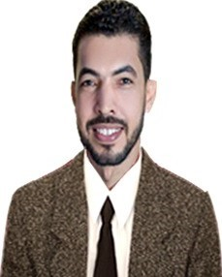
Project Manager “ Instructor”
Nader El Habashy
Arwa Nagy
Ahmed Soudi
Amira Nasr
Osama Fouad
Doaa Saleh

Slide 8
Project Challenges: Approaches and Expected Outcomes :
In response to the growing trend of digitalization, digital transformation has become an essential strategy rather than a mere option. This presentation explores how Knowledge University can leverage Oracle system solutions to streamline and optimize its HR processes, fostering greater efficiency, accuracy, and a data-driven approach to workforce management.
HR System Limitations: Inefficient data sharing between departments (e.g.: Employees, Finance, HR)
Performance & Training Gaps: Lack of real-time visibility into key performance indicators (KPIs)
Manual processes: leading to errors and delays ( Manual Paperwork)
Lack of HR Analytics: Difficulty in generating comprehensive reports for accreditation and HR- decision making
Integrate / real-time data which empowers decision- making based on accurate insights and analysis.
Automate workflows/ processes .
Improve reporting and data analysis for best taken-decisions.
Reduce manual errors and increase efficiency.

Slide 9
Project Challenges: Approaches and Expected Outcomes :
Inefficient data sharing between departments (e.g.: Employees, Finance, HR)
Lack of real-time visibility into key performance indicators (KPIs)
Manual processes leading to errors and delays
Difficulty in generating comprehensive reports for accreditation and compliance
Integrate / real-time data which empowers decision- making based on accurate insights and analysis.
Cost Efficient and effective: Automate workflows/ processes with lower operational cost .
Improve reporting and data analysis for best taken-decisions.
Reduce manual errors and increase efficiency.

Slide 10

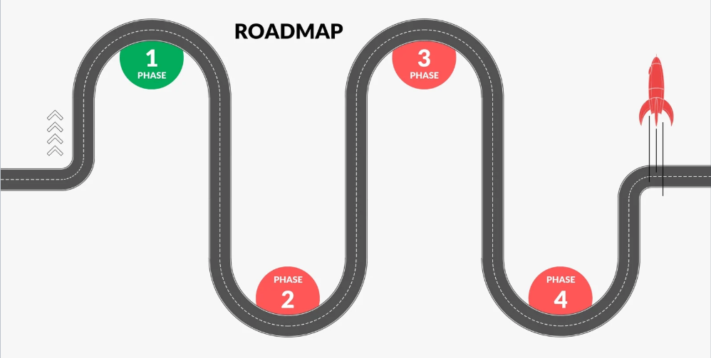
Project Roadmap:
System Configuration and Customization
Customize the Oracle HR system to meet the university’s specific needs.
Testing and Quality Assurance
Validate that the Oracle HR system is functioning as expected and meets university needs.
Needs Assessment and Requirement Gathering
Understand and document the specific HR Requirements of the university to tailor the Oracle system accordingly
User Training and Change Management
Ensure that all users are equipped to effectively use the new HR system and adapt to changes.
Data Migration and System Go-Live
Transition from the old HR system to the Oracle HR system.
Post-Go-Live Support and Optimization
Provide ongoing support and continuous improvement post-implementation.
Project Closure and Final Reporting
Officially close the project and document the outcomes.

Slide 11

Knowledge University
Organization Structure
Executive Level
Top Management
Dean
Student
Affairs
Human Resources
IT & Facilities
Finance
Faculty Affairs
Compensation & Benefits
Recruitment & Staffing
Training & Development
Personnel
Network Services
System Administration
Academic Technology
Maintenance
Public Safety
Cleaning & Custodian
Graduate Studies
Undergraduate Studies
Research
Counseling & psychological
Health services
Customer Service
Procurement
Risk Management
Facilities Management
Controller
Payroll
Treasurer
Finance
Undergraduate Education
Graduate Education
Arts & Science
Engineering
Business
Law
Medicine
English
Biology
History
Computer Science
Libraries

Slide 12
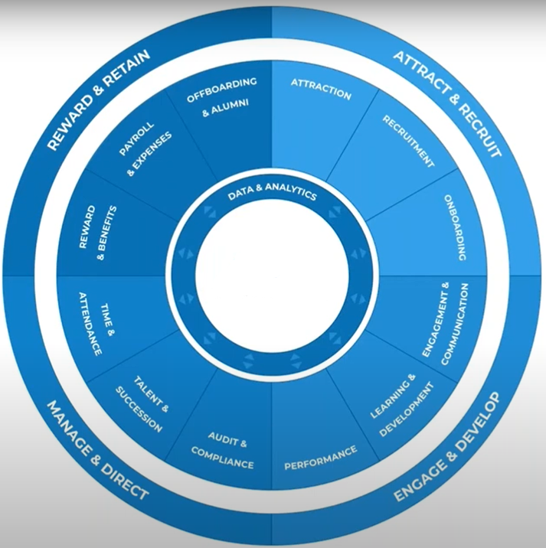
Project Scope and Key Modules
The HR Oracle ERP system follows a structured setup, with modules to complete workflow.
System Module:
User Management & Access Control ( Essential Module) : Users Accounts, responsibilities, Employees personal details and access levels. (Automated onboarding reducing paperwork by 60%)
People Management Setup: Employees type (Full-Time, Part-Time), admissions, Student academic records. (Improved student self-service resulting in 20% fewer help desk calls)
Work Structure Setup: Organizational Structure, Employees’ positions and grades.
Finance Management Setup( Payroll): salary elements, bank account details, payroll , compensation based on grades, overtime and salary adjustment approval workflow (Target: reduce monthly close time by 5 days).
ERP System

Slide 13
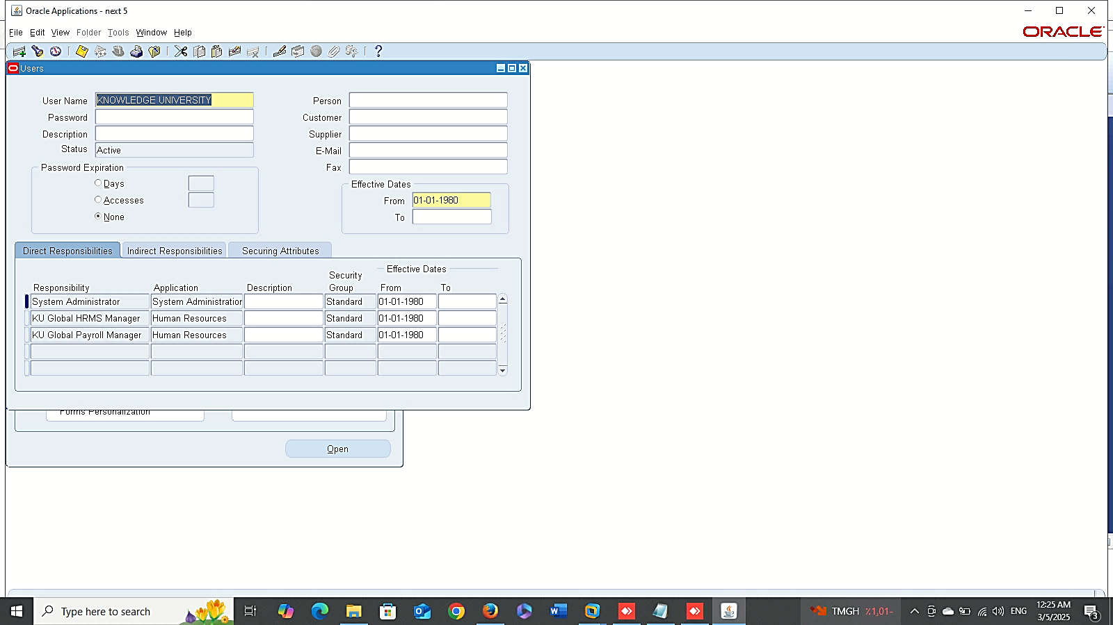

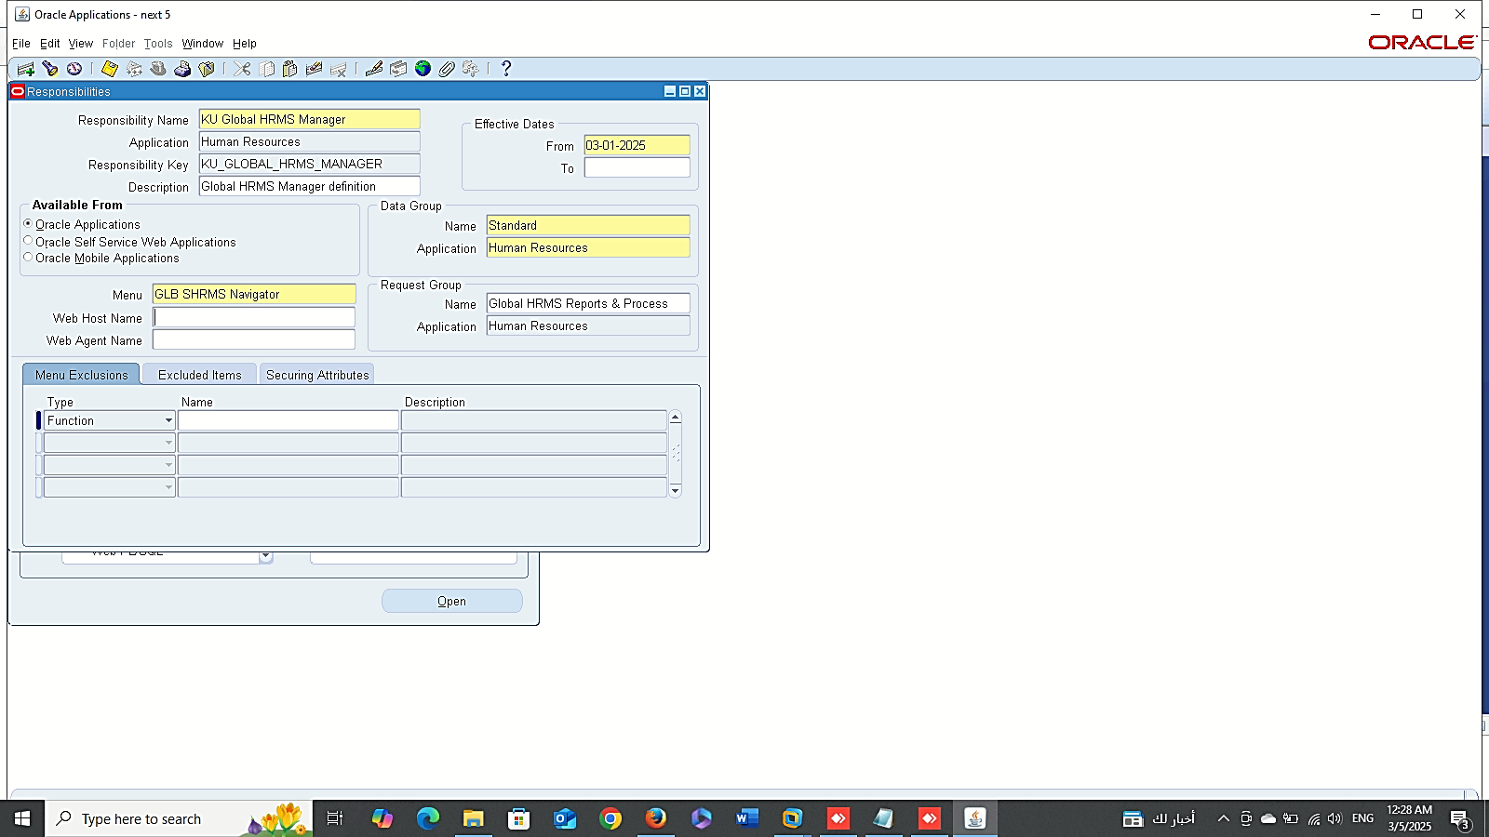
Create User
User Management & Access Control ( Essential Module)
Create User :
Navigate to: Sysadmin Responsibility > Security > User > Define
Assign a unique username, password, and expiration date.
Create Responsibility :
Navigate to: Sysadmin Responsibility > Security > Responsibility > Define
Create Responsibility

Slide 14
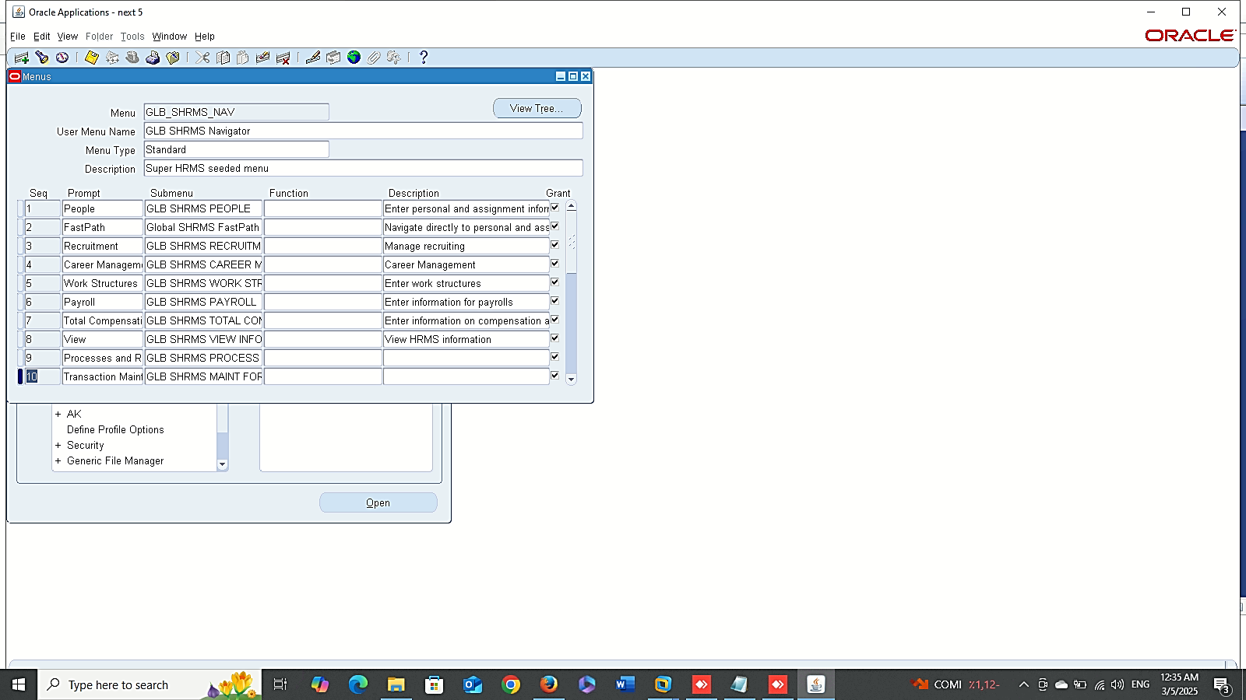
Search Menu
User Management & Access Control ( Essential Module)
Edit Menu:
Search Menu: Sysadmin Responsibility > Security > Responsibility > Define
Edit Menu: Sysadmin Responsibility > Application > Menu.
Edit Menu

Slide 15
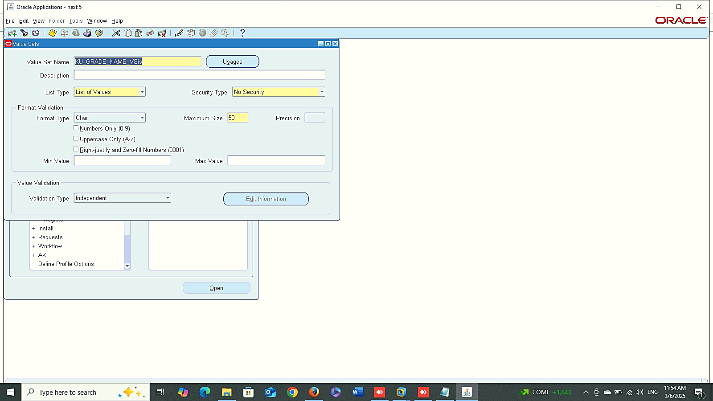
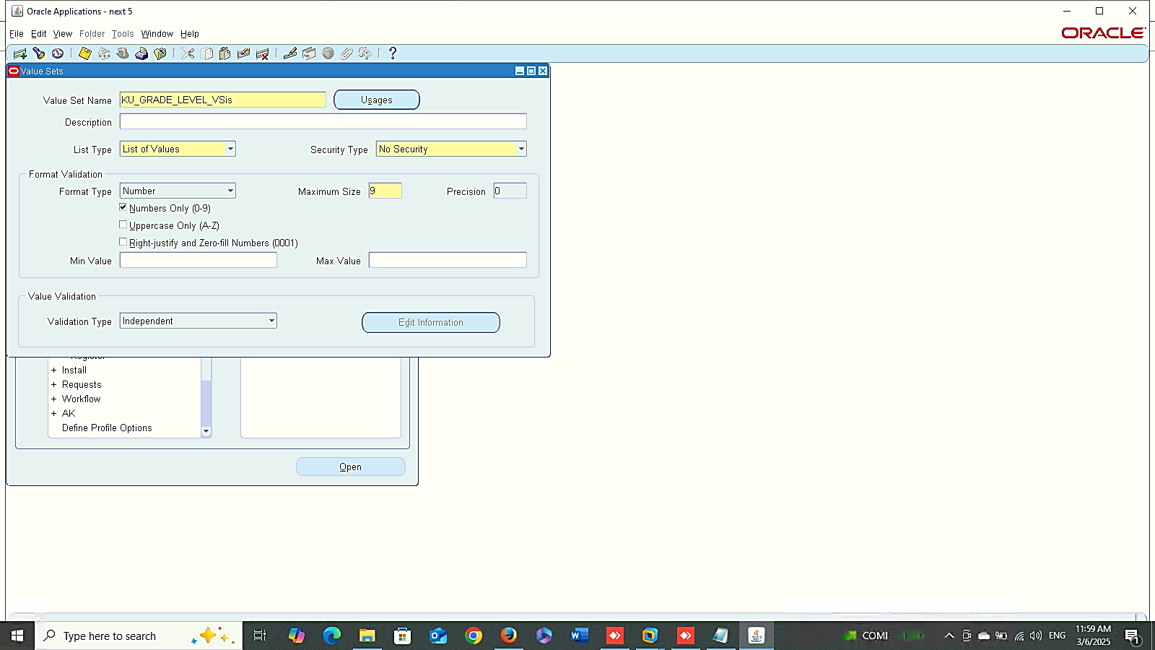
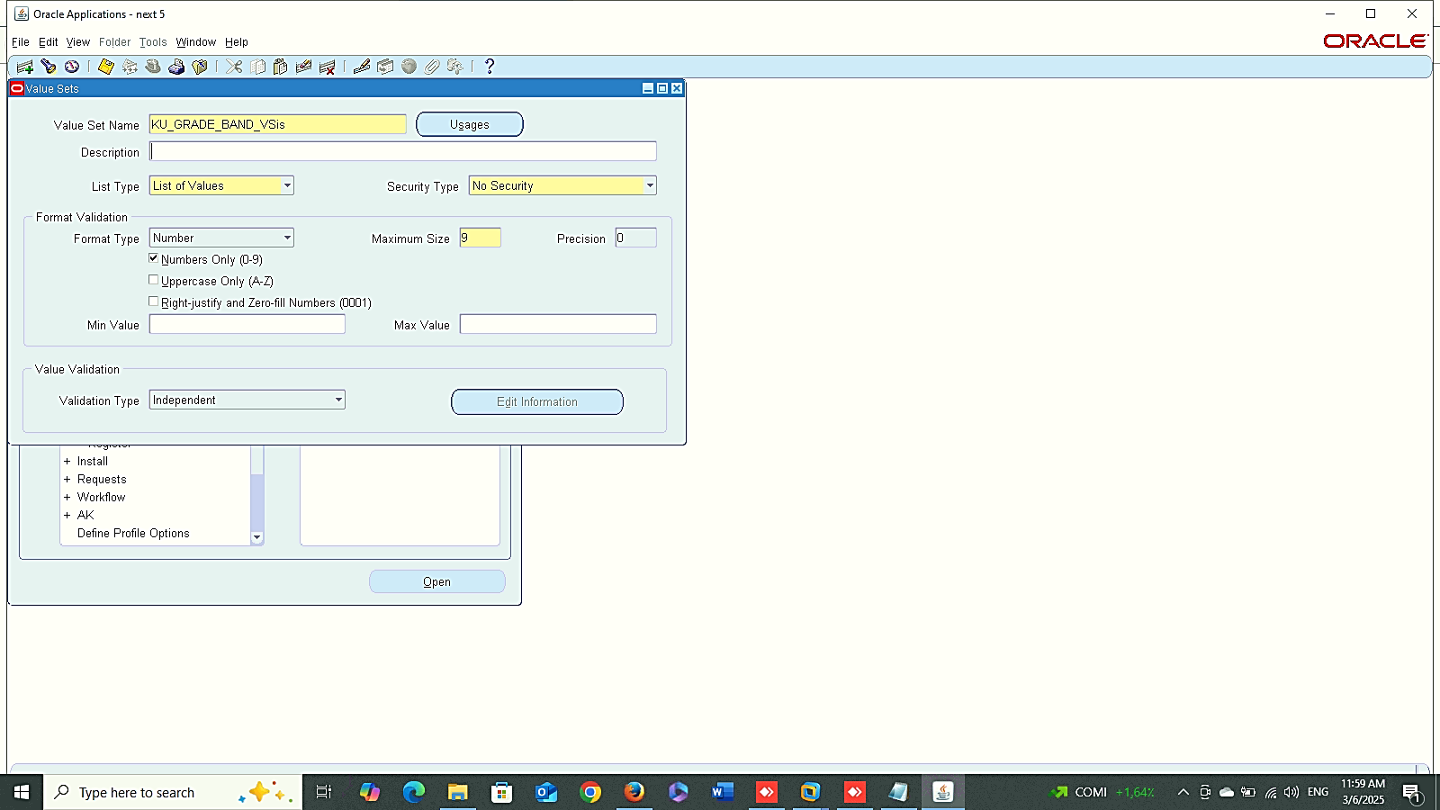
1
User Management & Access Control ( Essential Module)
Create Value Set:
system administrator > Application > Validation > SET
Grade
2
3

Slide 16
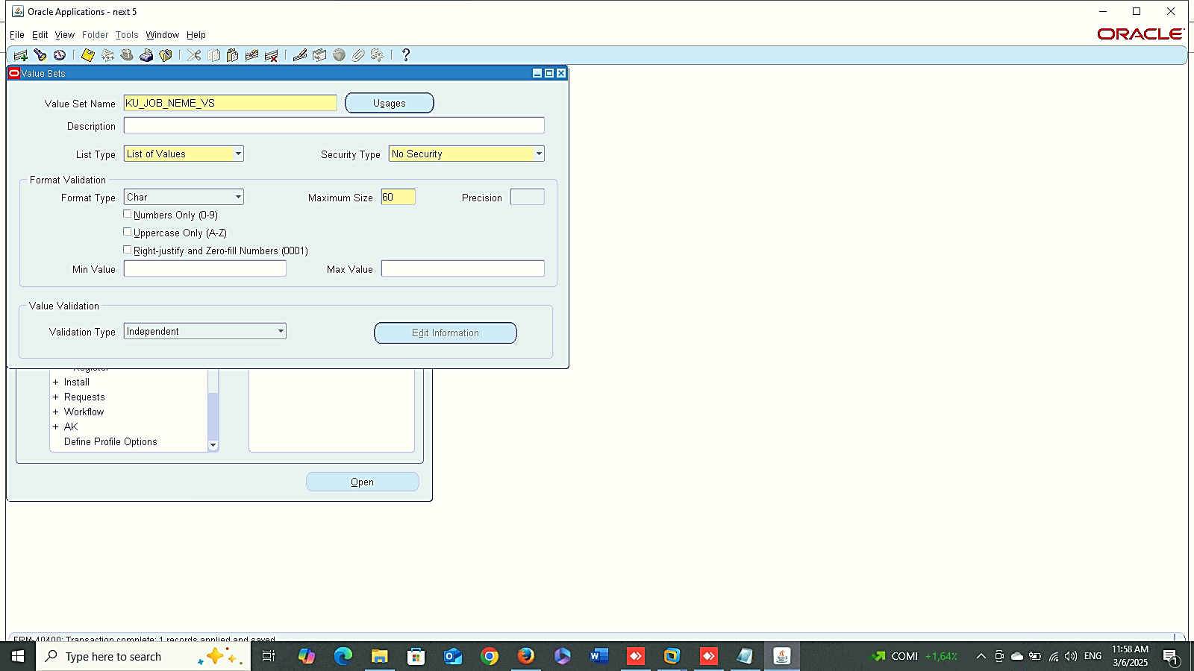

Job
User Management & Access Control ( Essential Module)
Create Value Set:
system administrator > Application > Validation > SET
Job
Position
Position

Slide 17
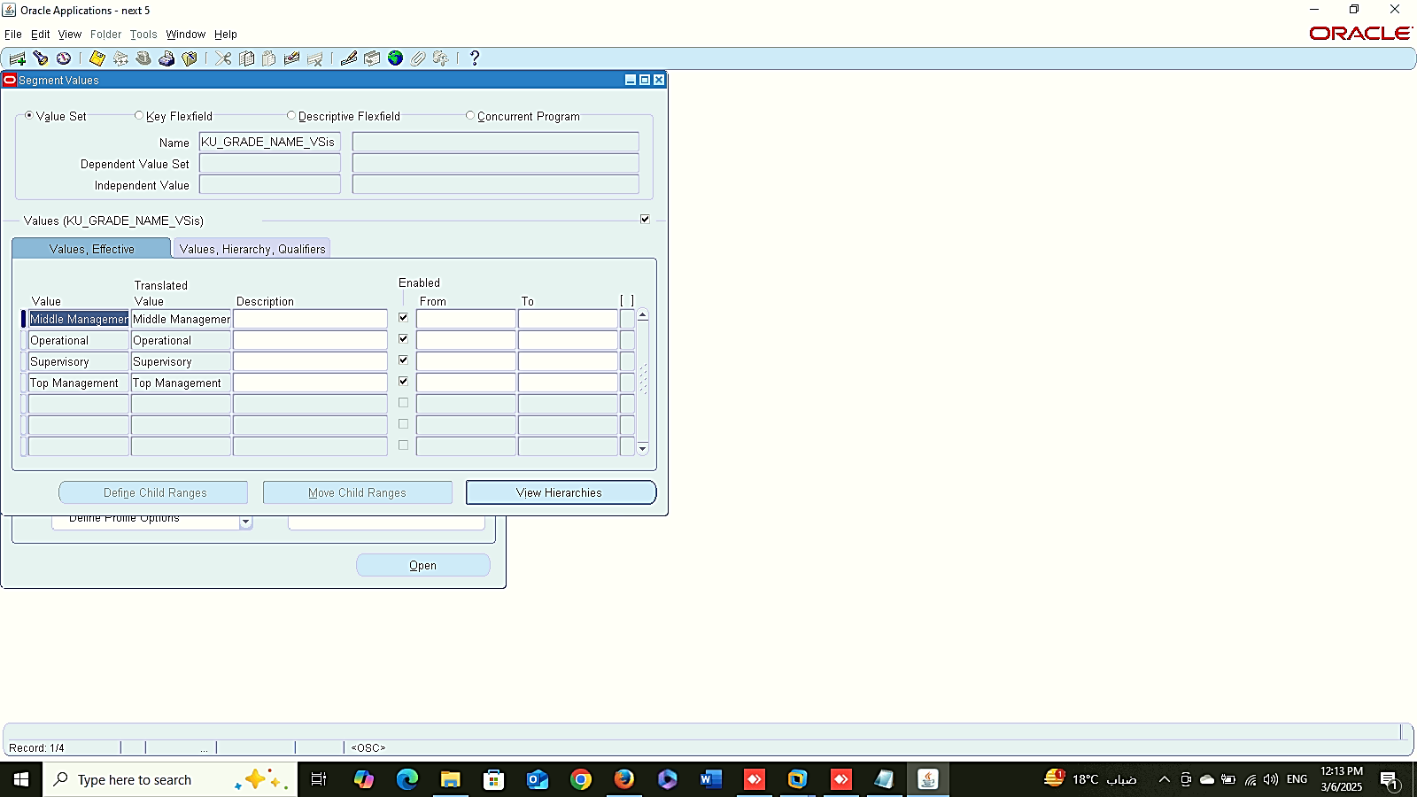
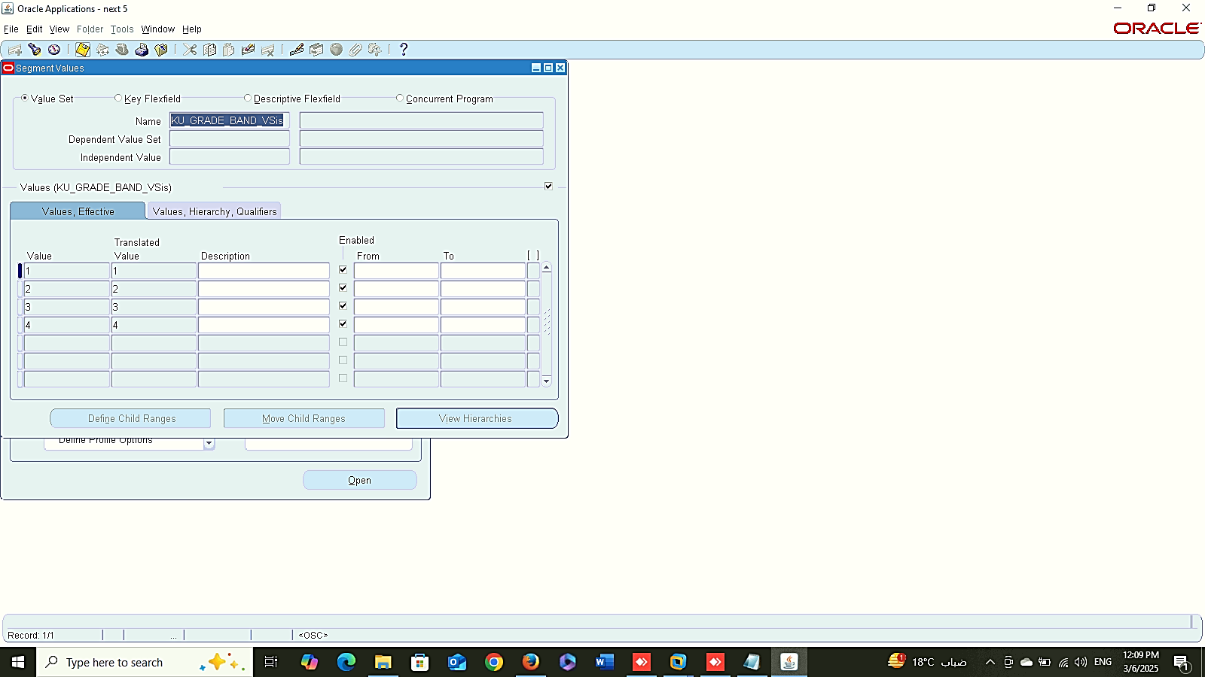

1
User Management & Access Control ( Essential Module)
Insert Data inside Value Set:
system administrator > Application > Validation > VALUE
Grade
2
3

Slide 18
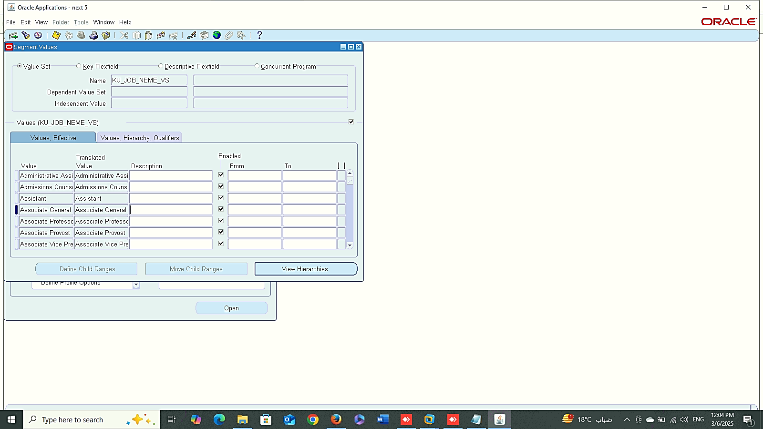
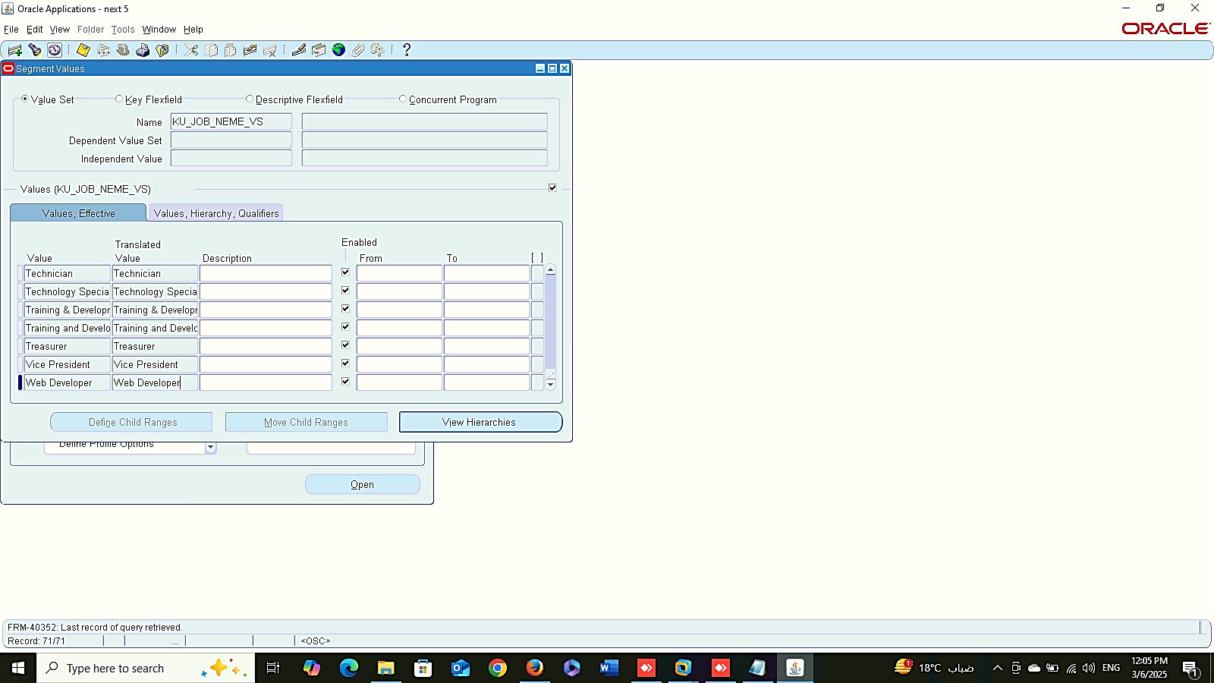


Job
1
2
User Management & Access Control ( Essential Module)
Insert Data inside Value Set:
system administrator > Application > Validation > VALUE
Job
Position
Position
1
2

Slide 19
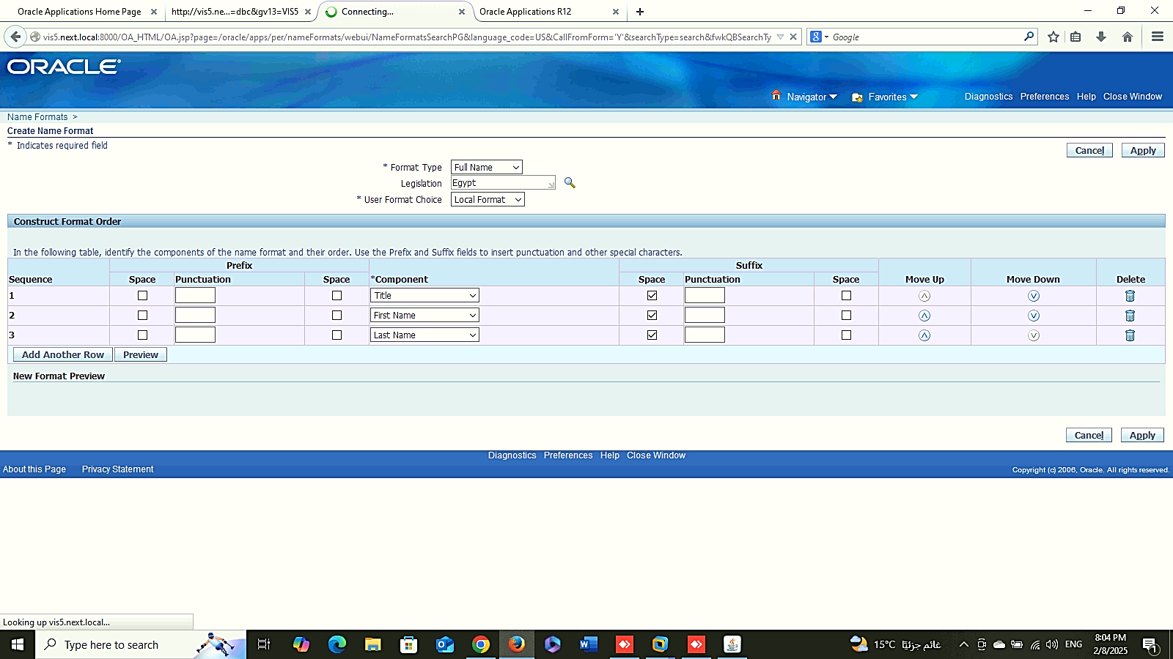
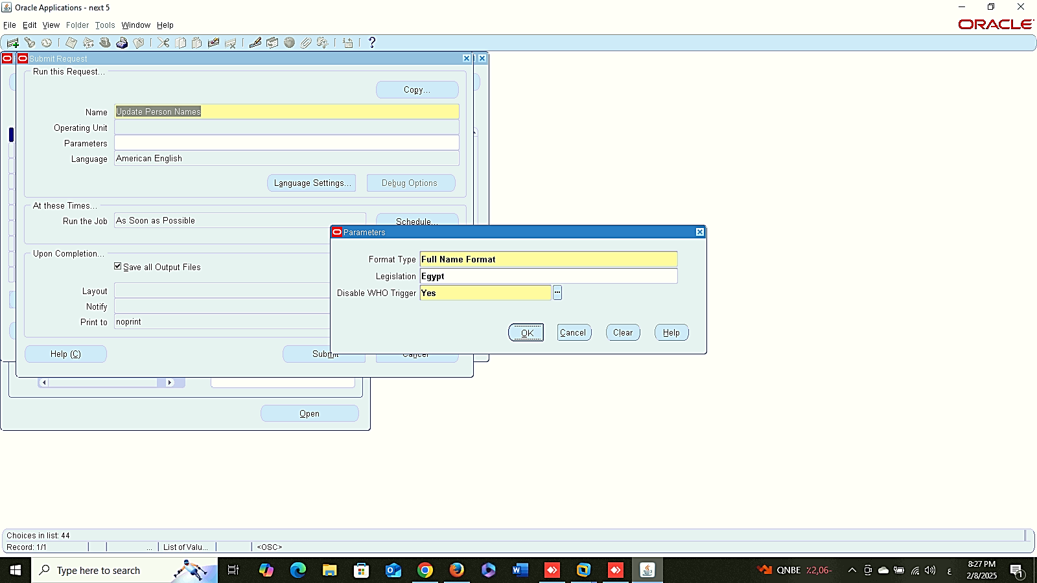
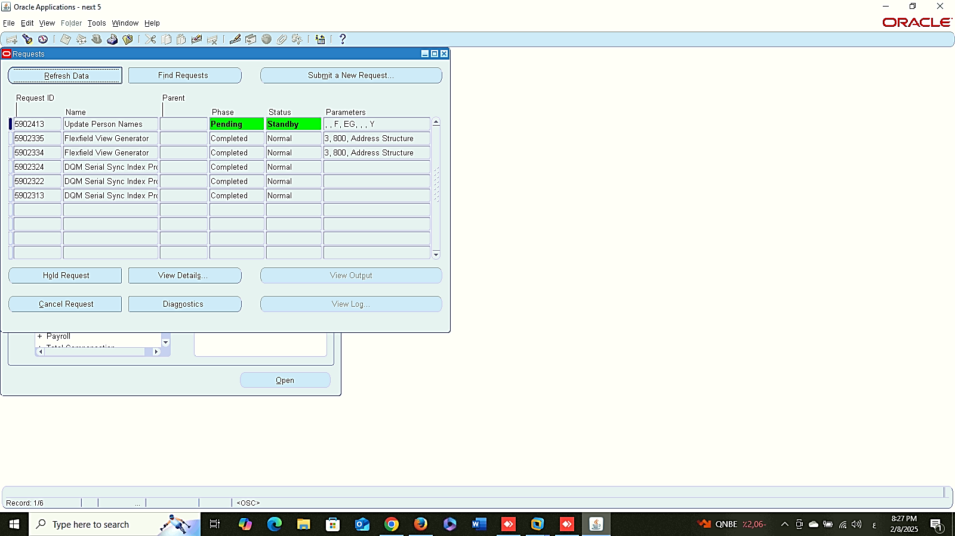
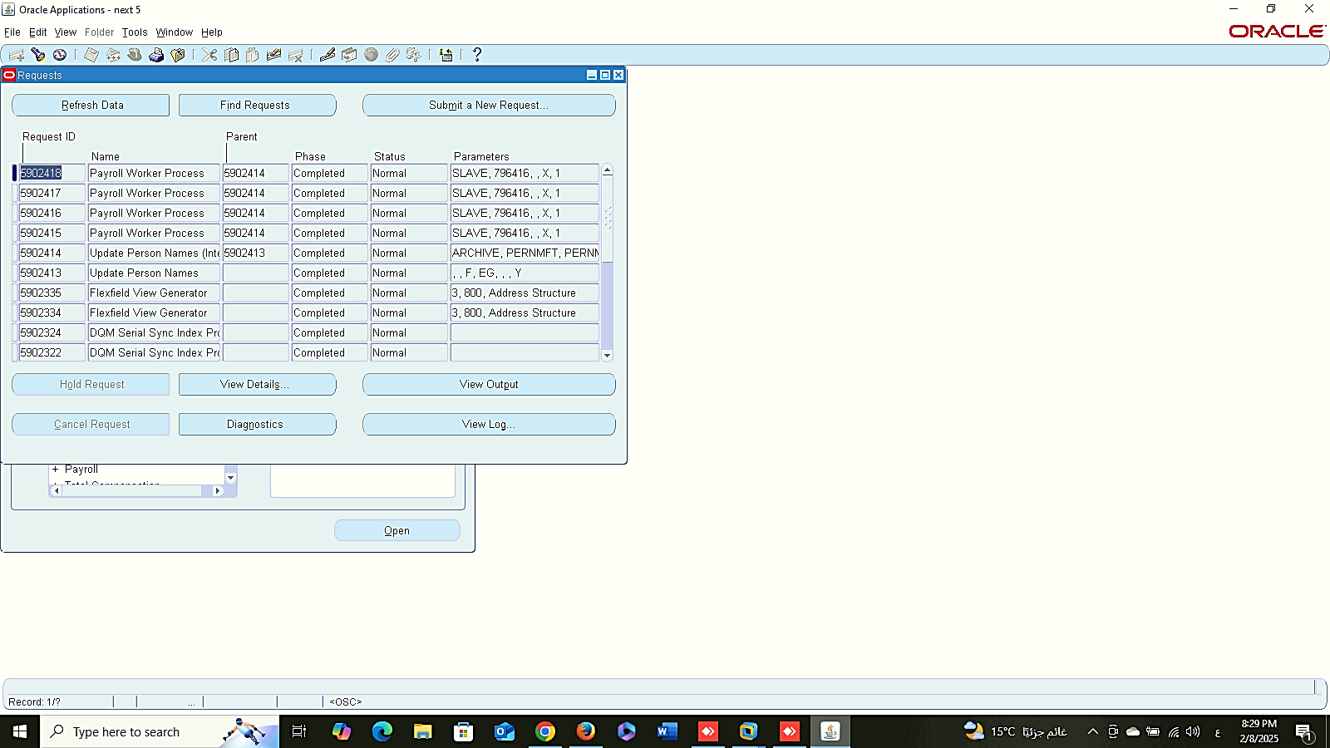
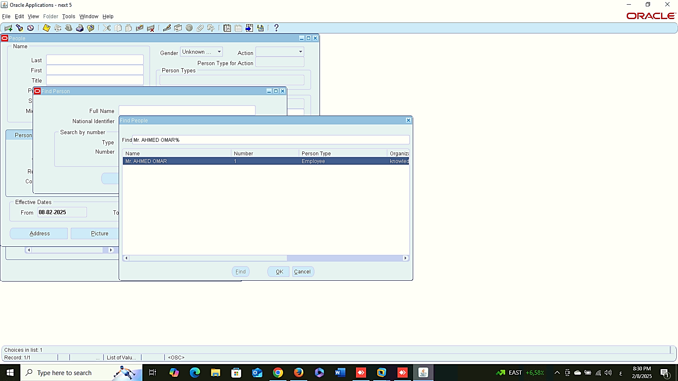
Person Name Format
1
Update Personal Name
People
Management
Person Name Format:
Global HRMS MANAGER > OTHER DEFINITIONS > PERSON NAME FORMATS
Request ( Update Person Name):
Global HRMS MANAGER > VIEW > REQUESTS > SUBMIT A NEW REQUIST
Update Personal Name
2
3
4

Slide 20
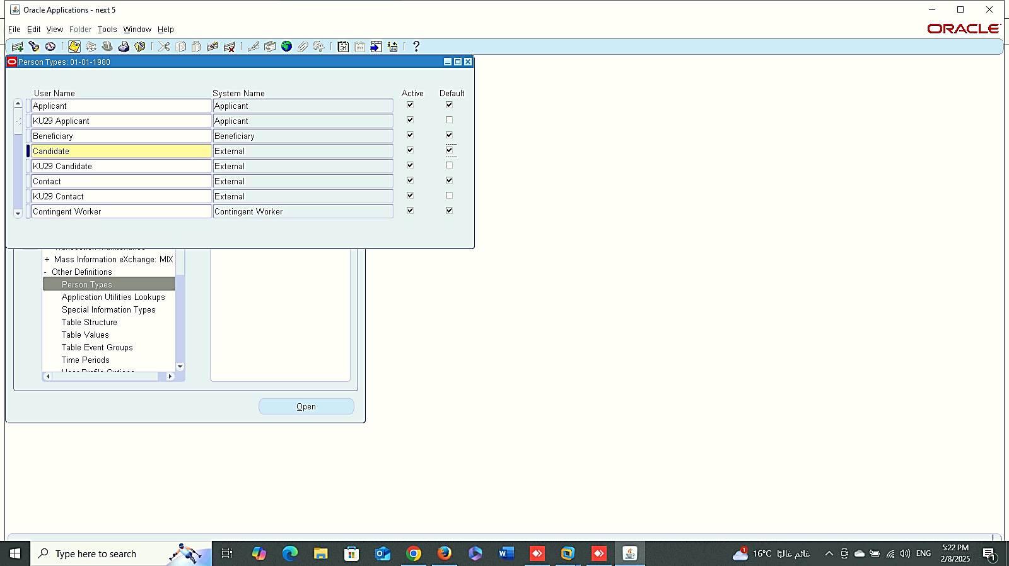
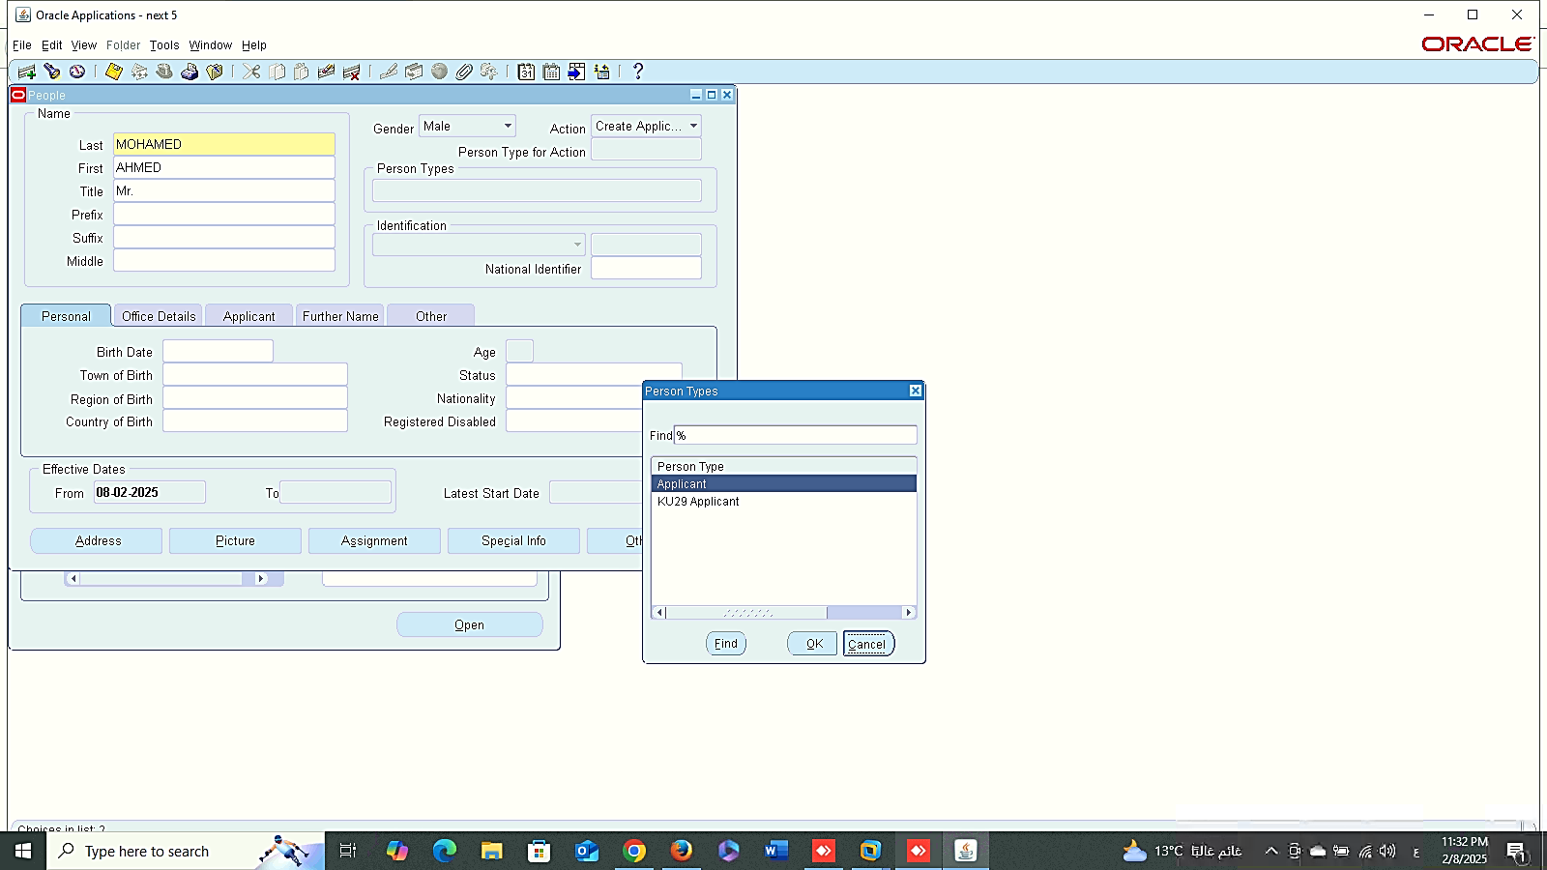
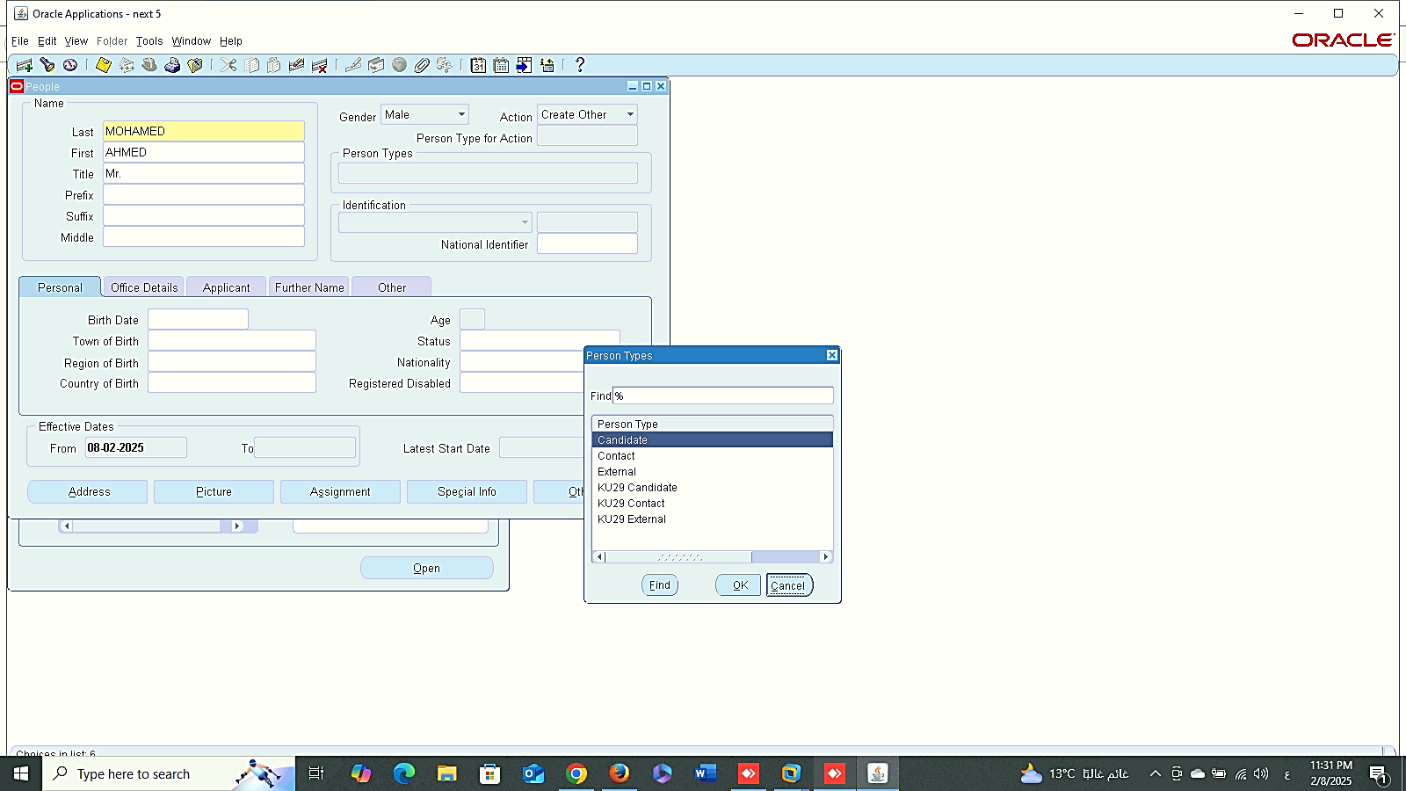


1
2
People
Management
Person Type:
Global HRMS MANAGER > OTHER DEFINITIONS > PERSON TYPE
3
4
5

Slide 21
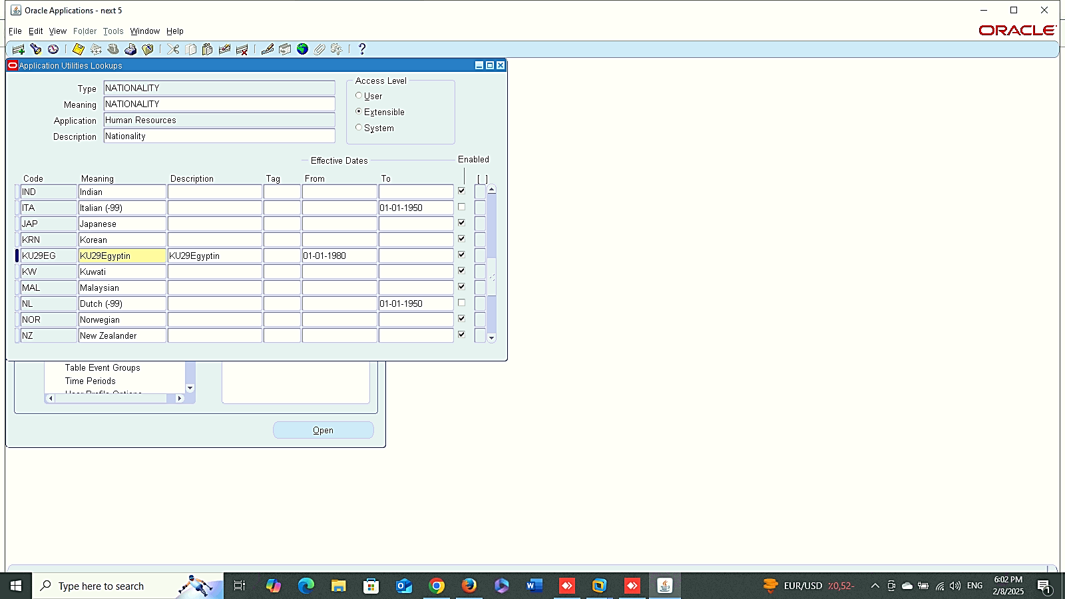
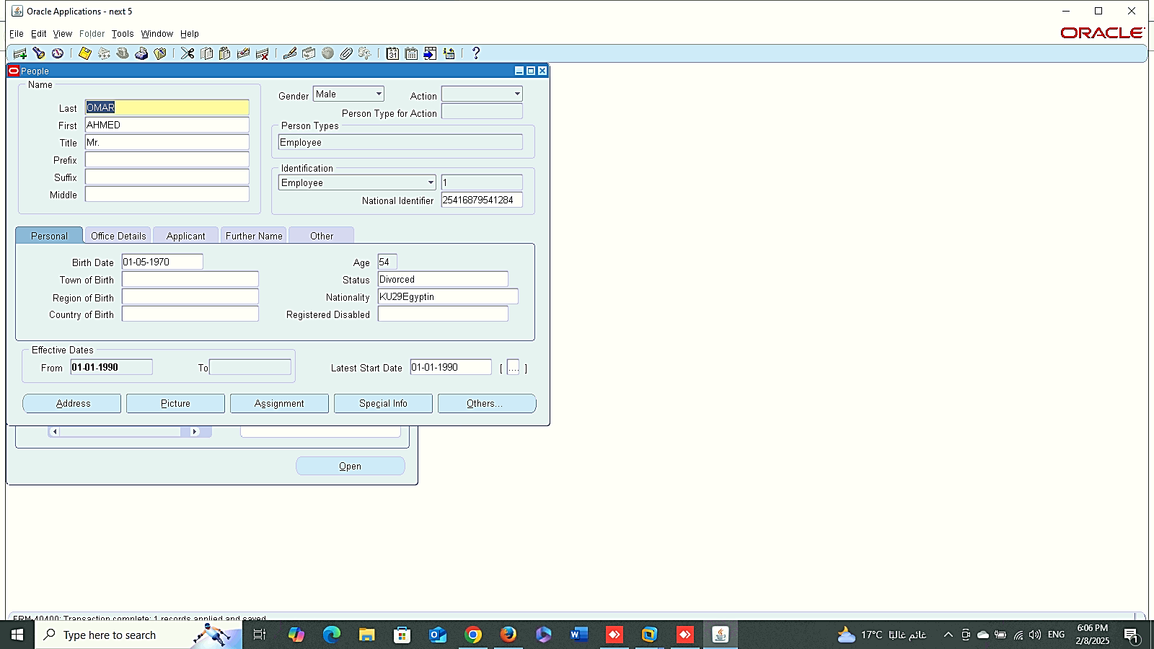
1
People
Management
Nationality Lookups:
Global HRMS MANAGER > OTHER DEFINITIONS > APPLICATION UTILITIES LOOKUPS
2

Slide 22
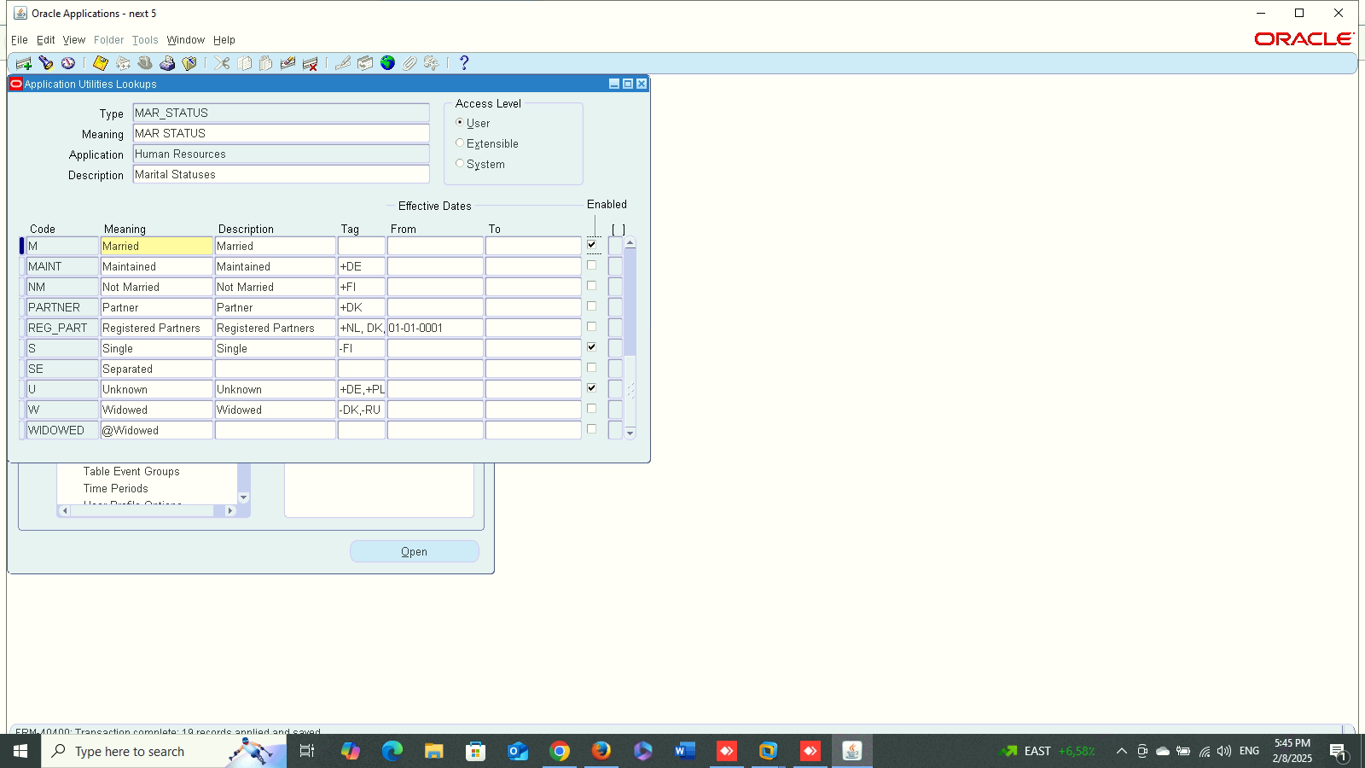
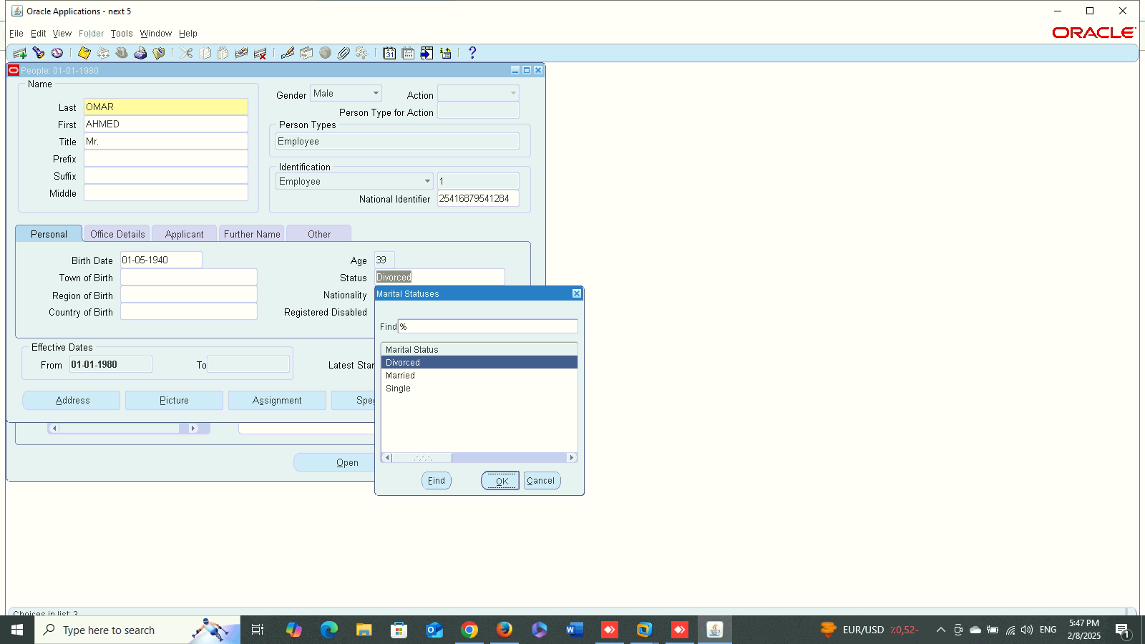
1
People
Management
Status Lookups:
Global HRMS MANAGER > OTHER DEFINITIONS > APPLICATION UTILITIES LOOKUPS
2

Slide 23

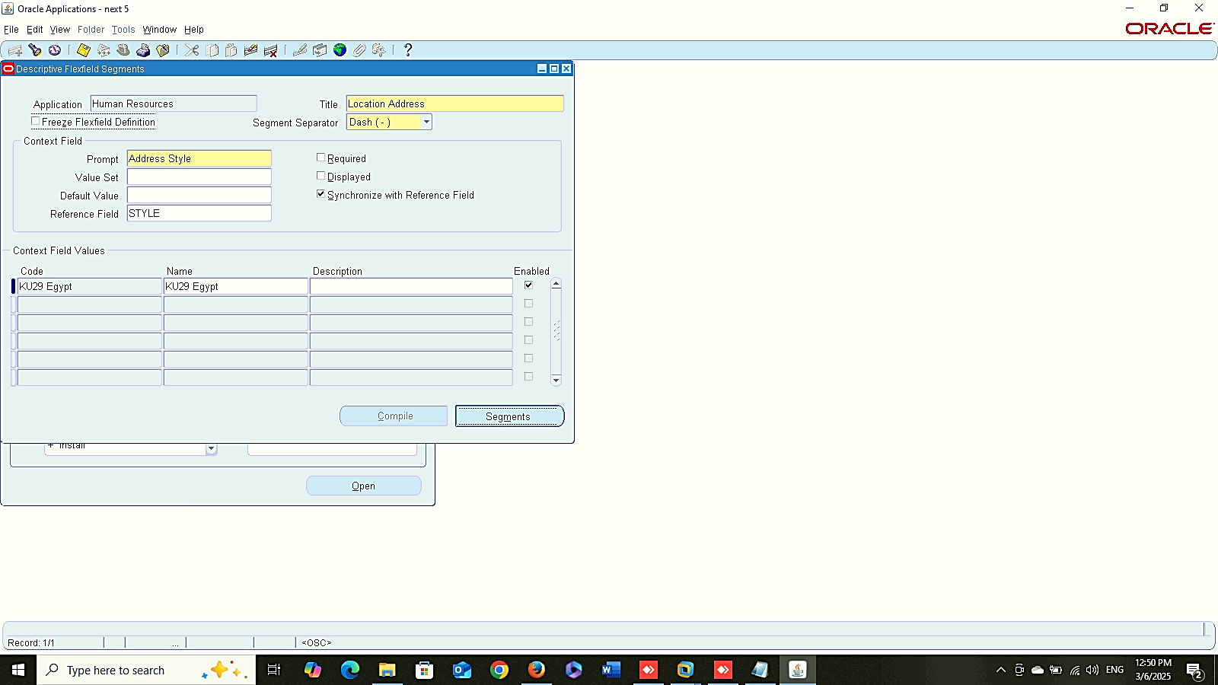
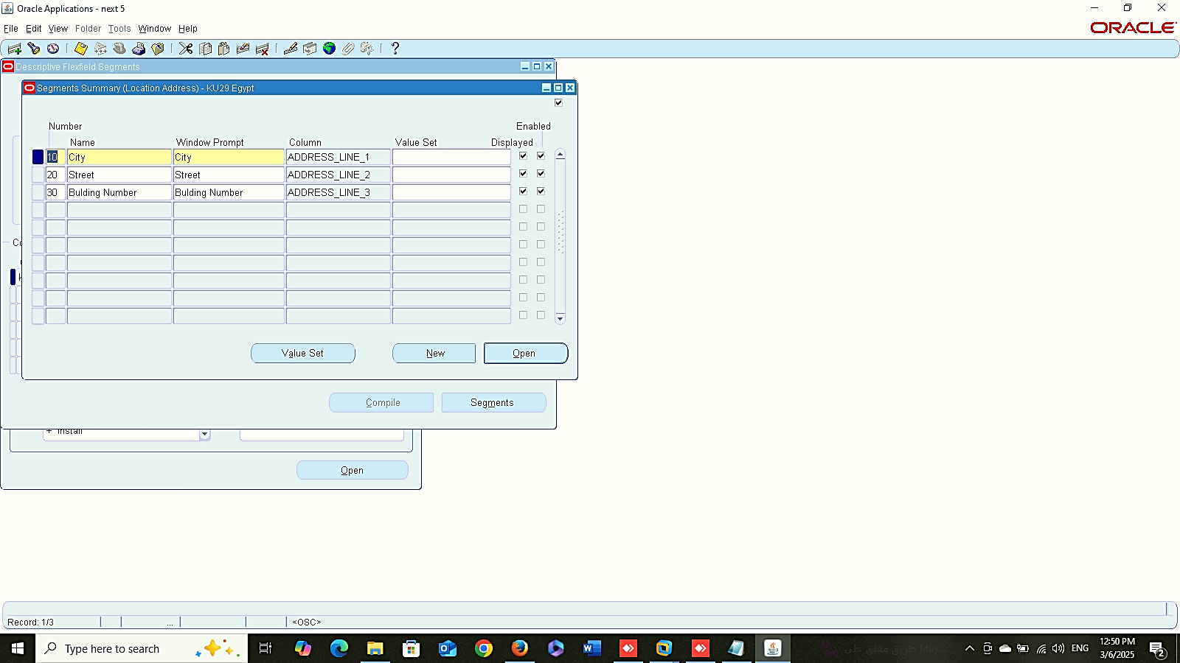
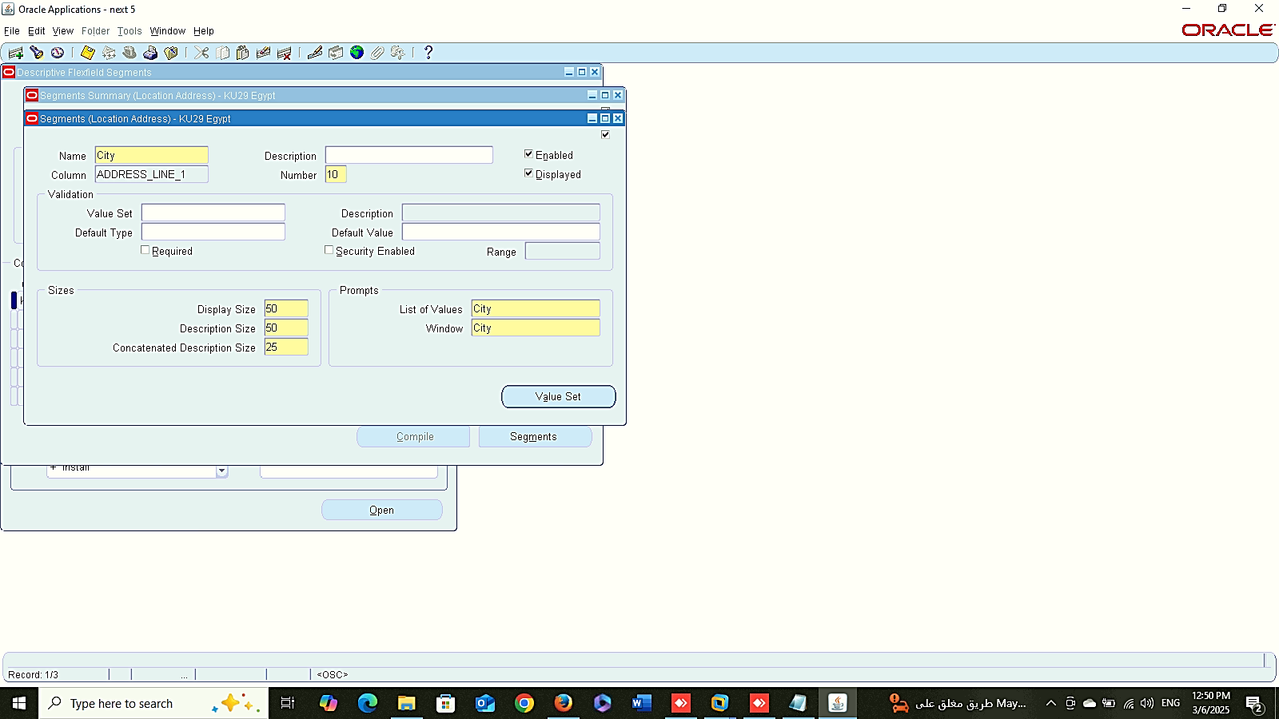
Add Responsibility
1
Descriptive Flex-field
People
Management
Add Addresses:
Add Responsibility :
system administrator > SECOURITY > RESPONSIBILITY > DEFINE
2. Descriptive Flex-field Address :
system administrator > APPLICATION > FLEXEIELD > DESCRIPTIVE > SEGMENTS
2
Descriptive Flex-field
3
Descriptive Flex-field

Slide 24
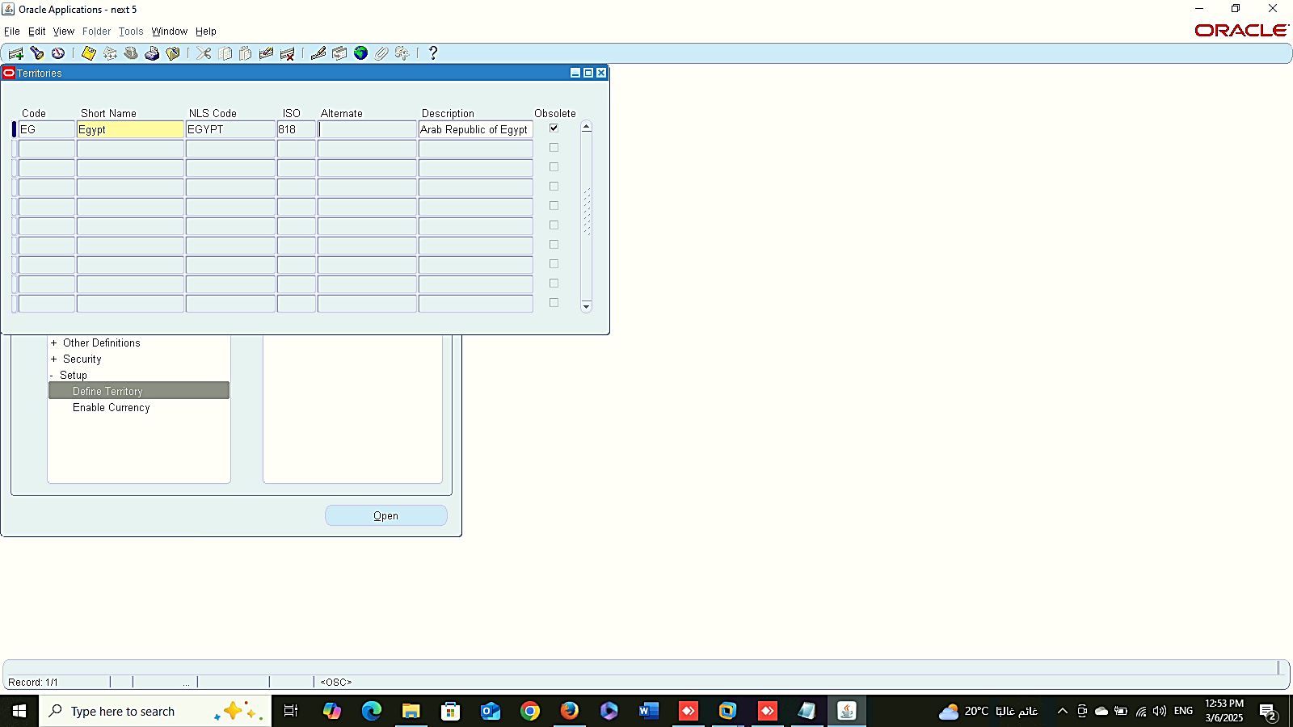
People
Management
Add Addresses:
3. Define Territory:
GLOBAL HRMS MANAGER> SETUP > DEFINE TERRITORY

Slide 25
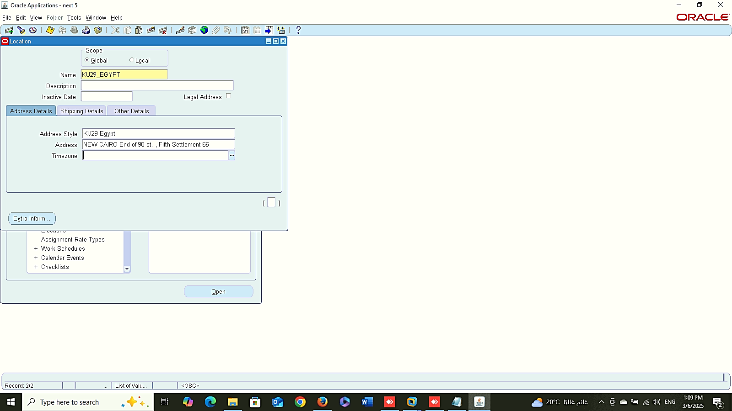
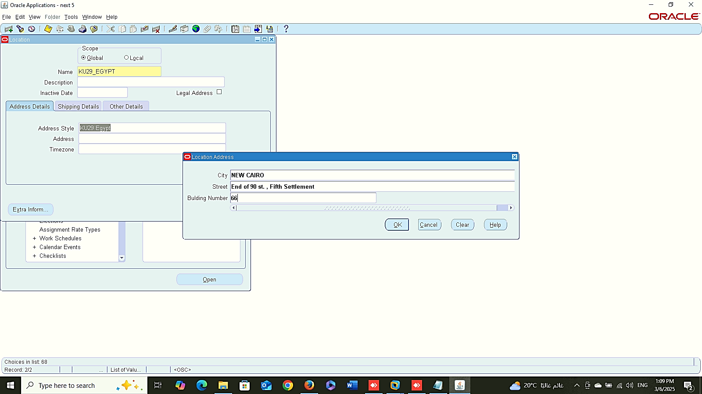
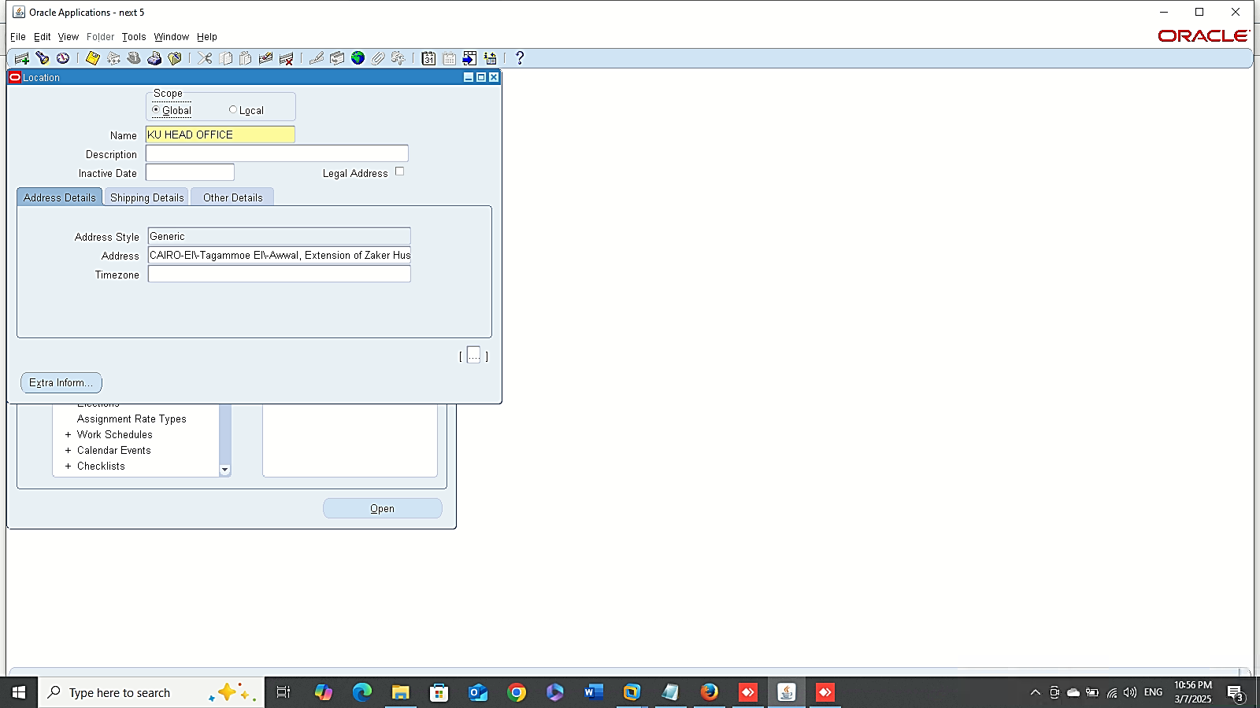
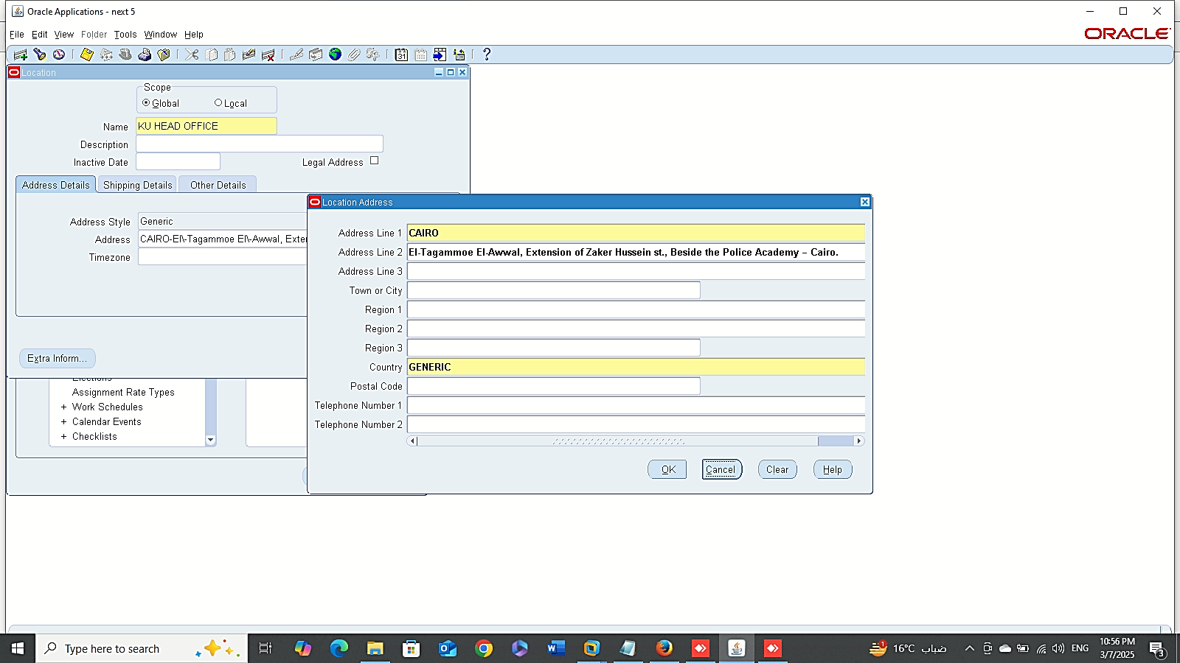
1
2
1
People
Management
Add Addresses:
4. Location:
GLOBAL HRMS MANAGER> WORK STRUCTURE > LOCATION
3
4

Slide 26
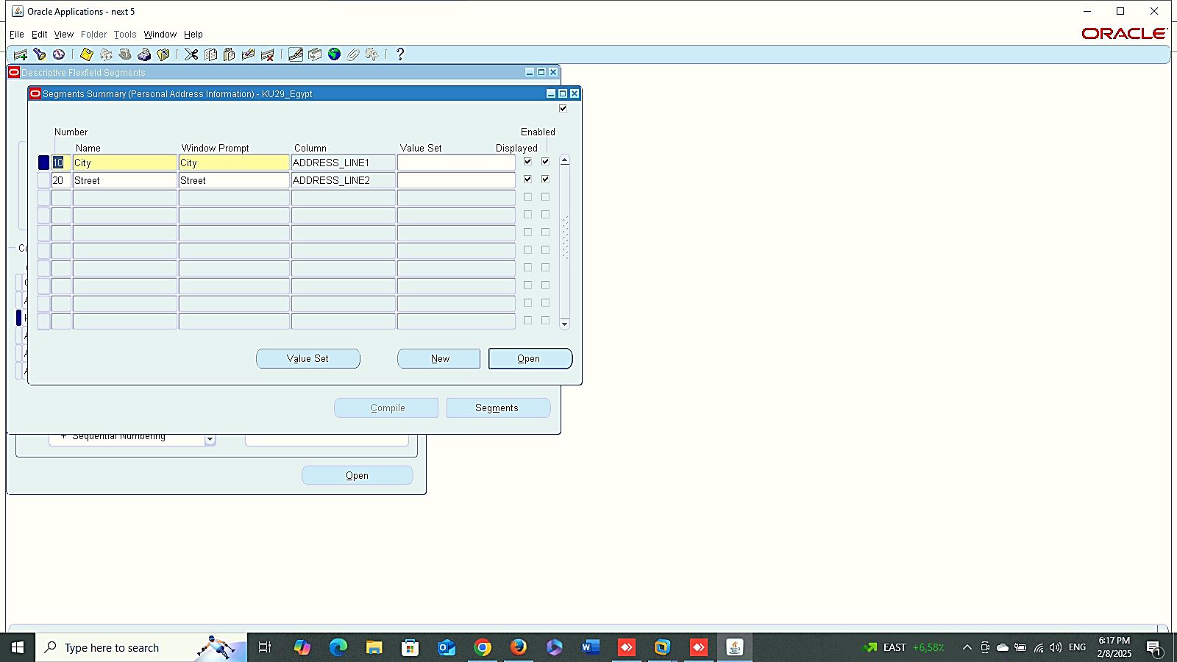
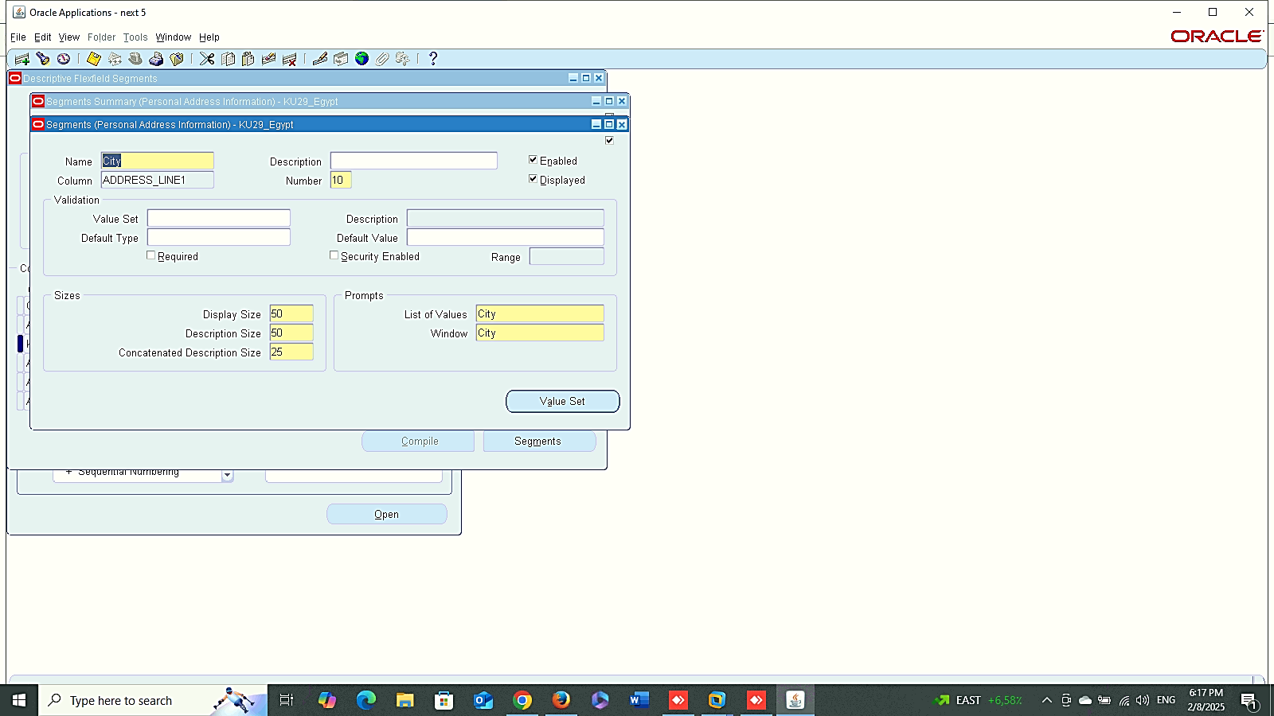
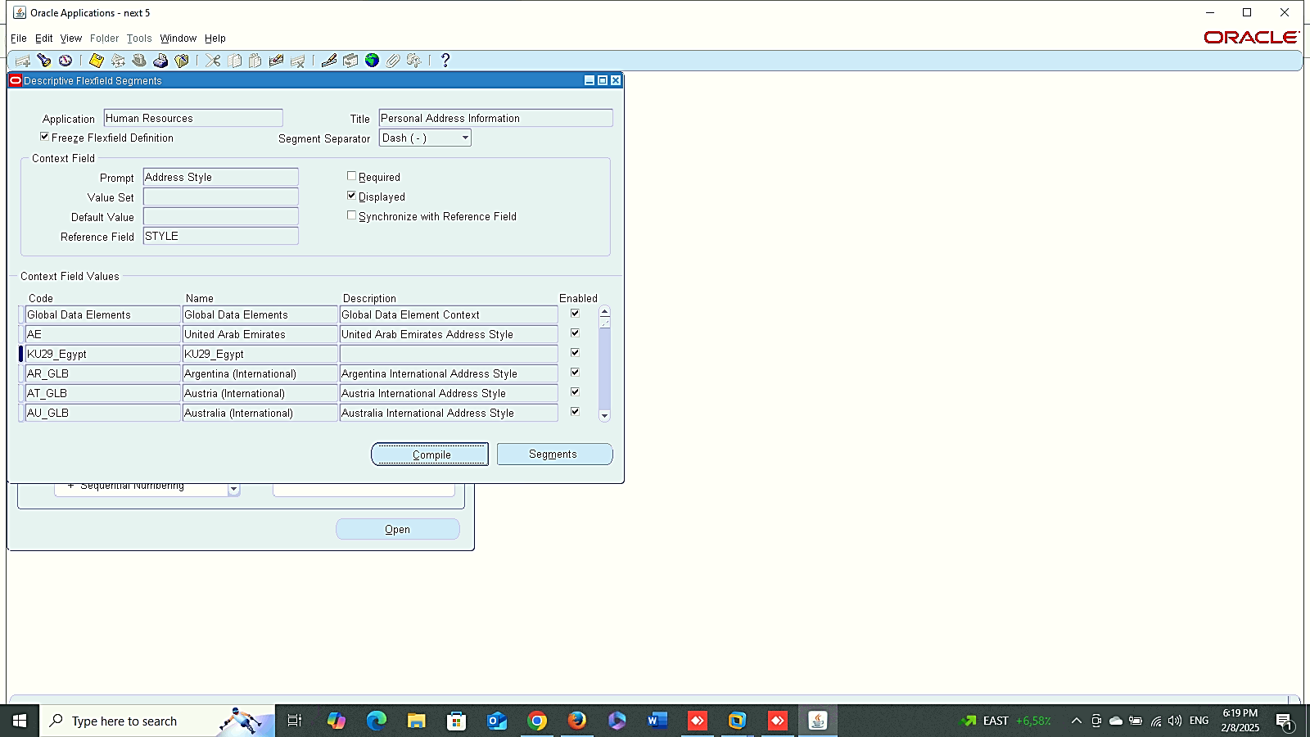
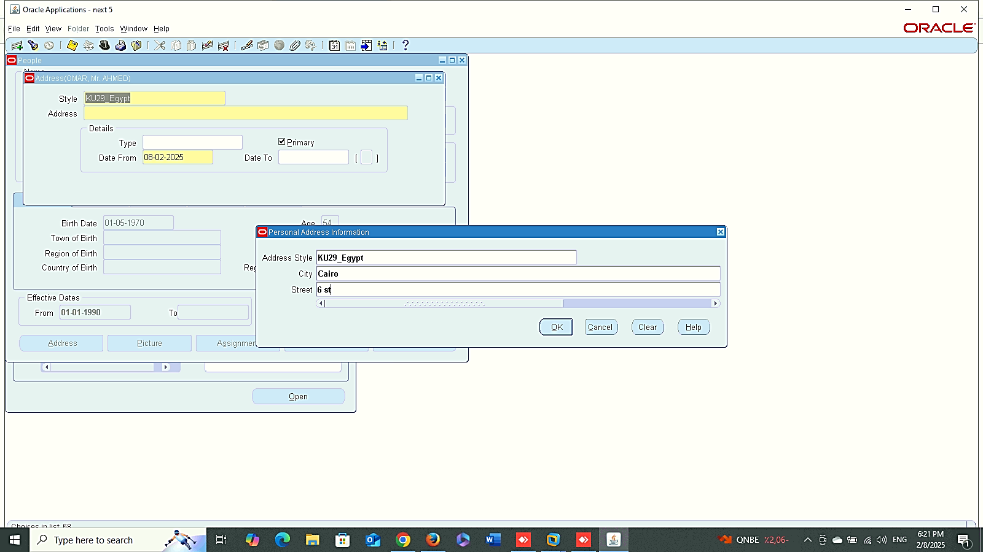
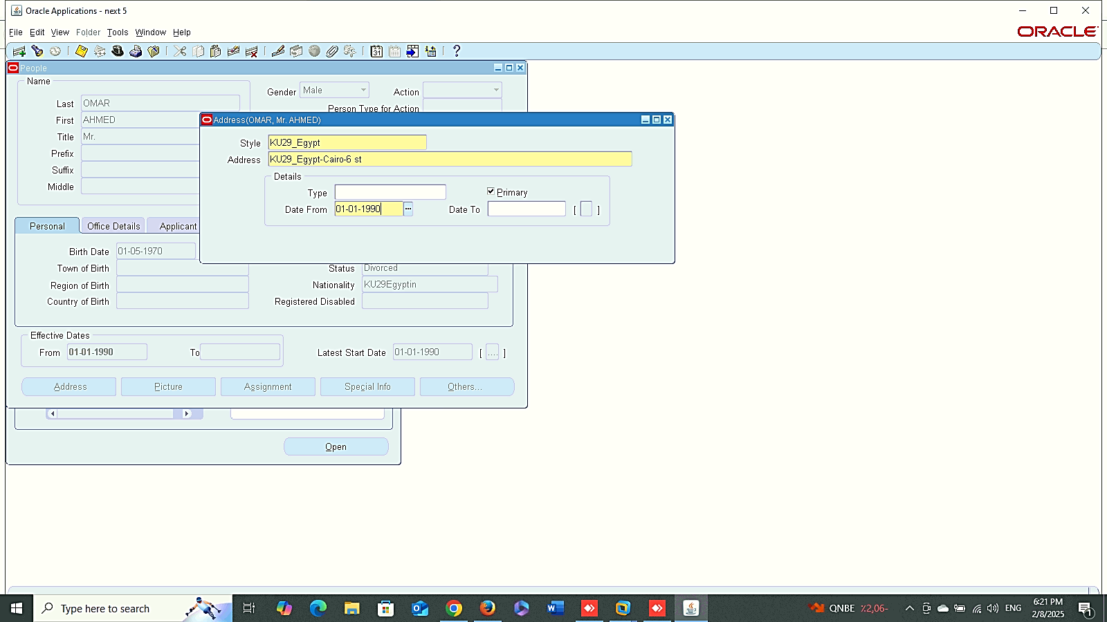
1
2
3
People
Management
Maintaining Addresses:
System administrator > Application > FLEXFIELD > DESCRIPTIVE > SEGMENTS
4
5

Slide 27
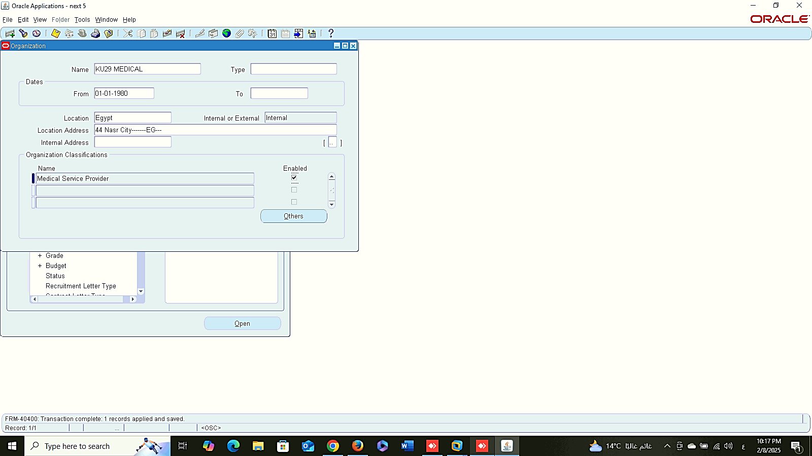
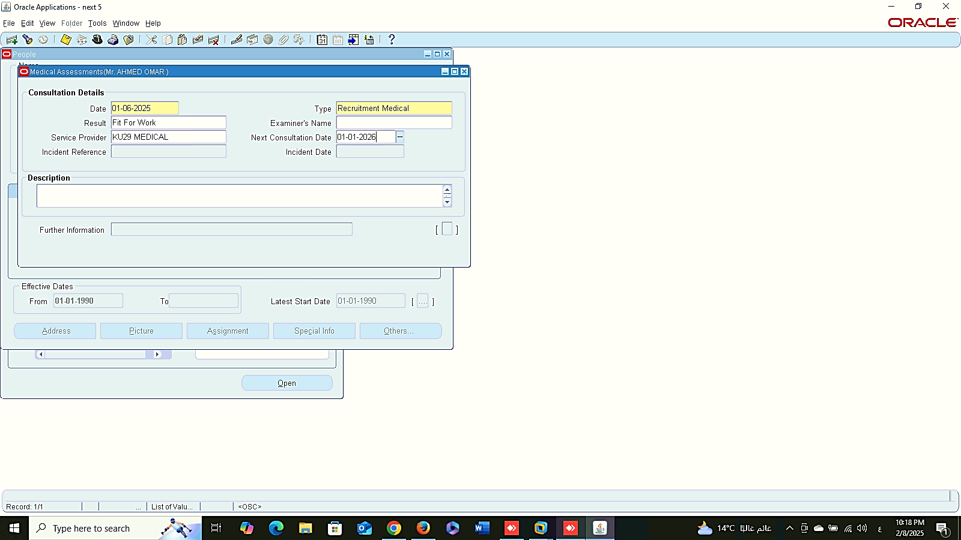
Add Organization
People
Management
Medical Assessments:
1- Add Organization:
Global HRMS MANAGER > PEOPLE > ENTER AND MAINTAIN > FIND > OTHER
2- Medical Assessment:
Global HRMS MANAGER > PEOPLE > ENTER AND MAINTAIN > FIND > OTHER
Medical Assessment

Slide 28
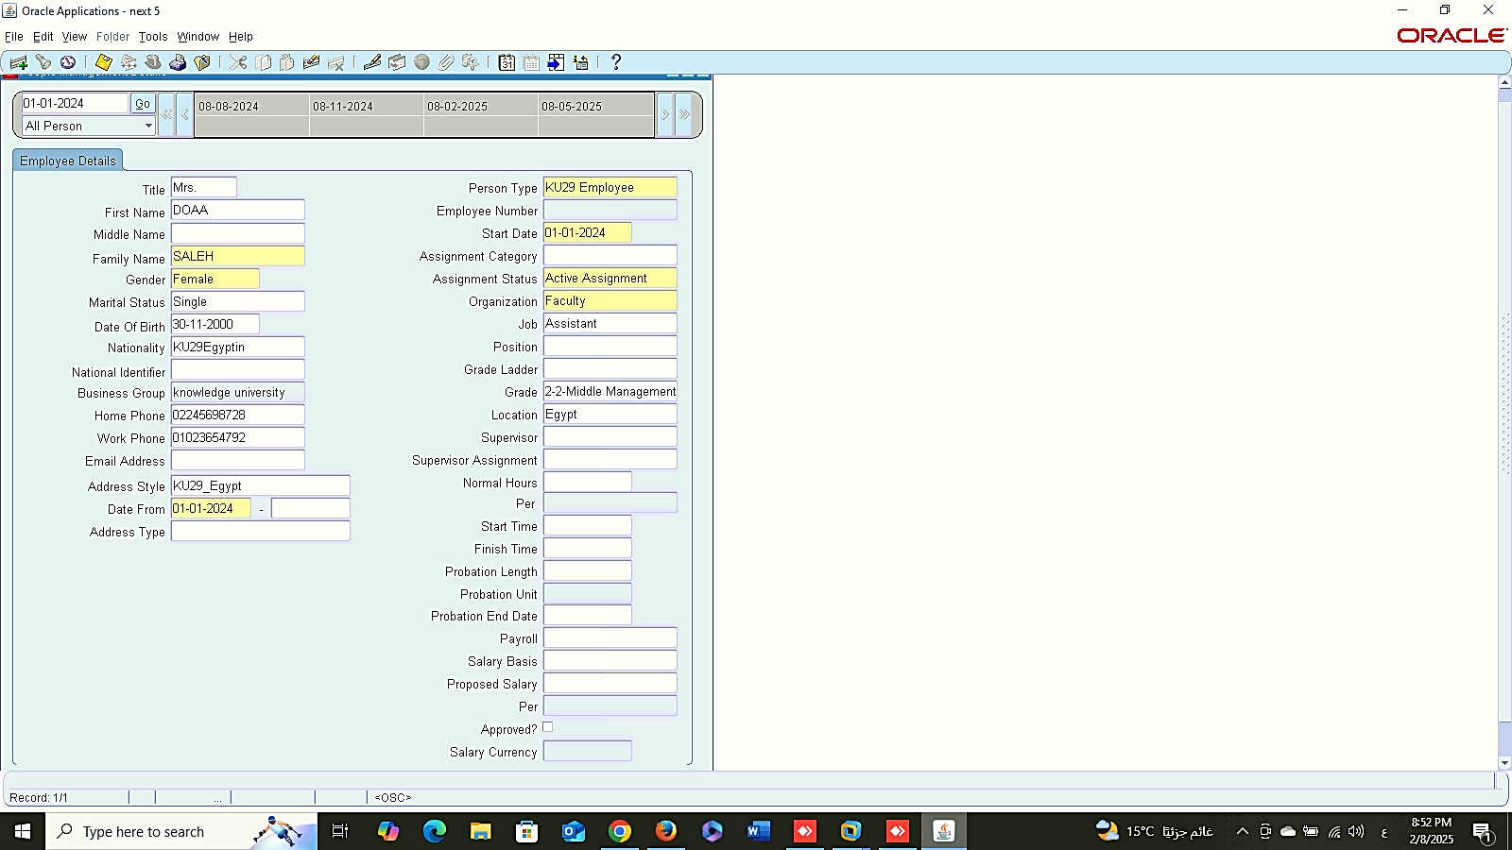
People
Management
Create An Employee Using Template:
GLOBAL HRMS MANAGER> PEOPLE> MAINTAIN USING TEMPLATES

Slide 29
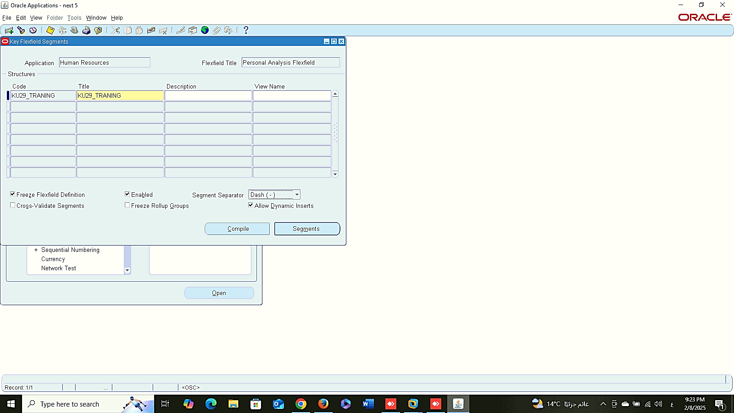
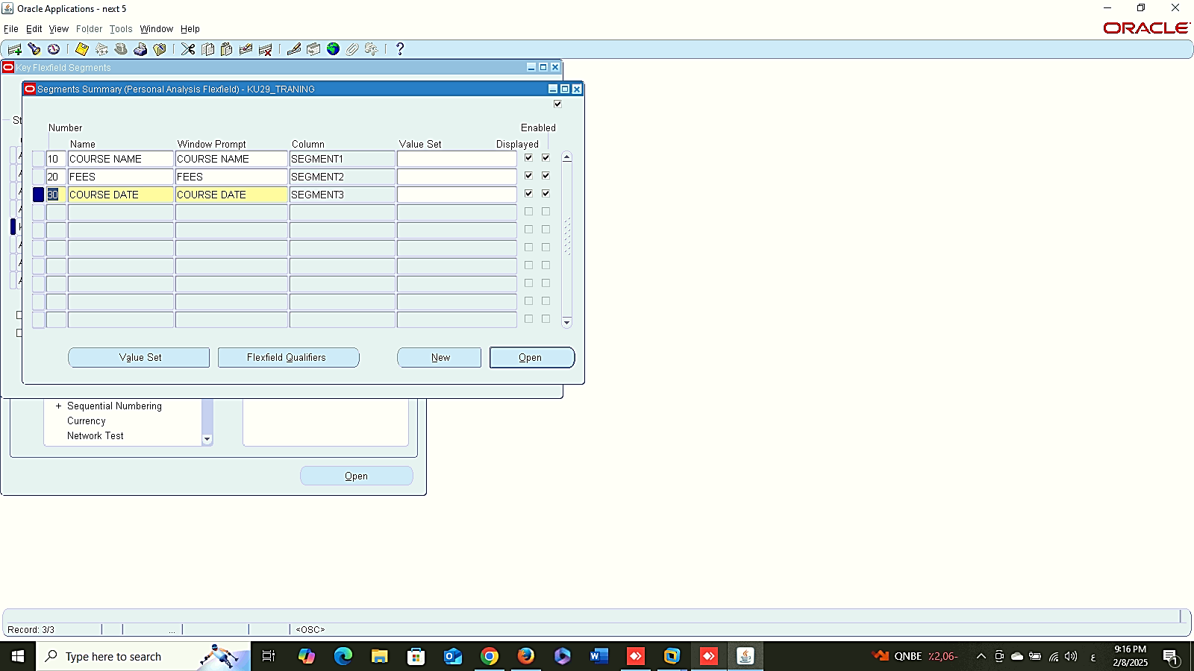
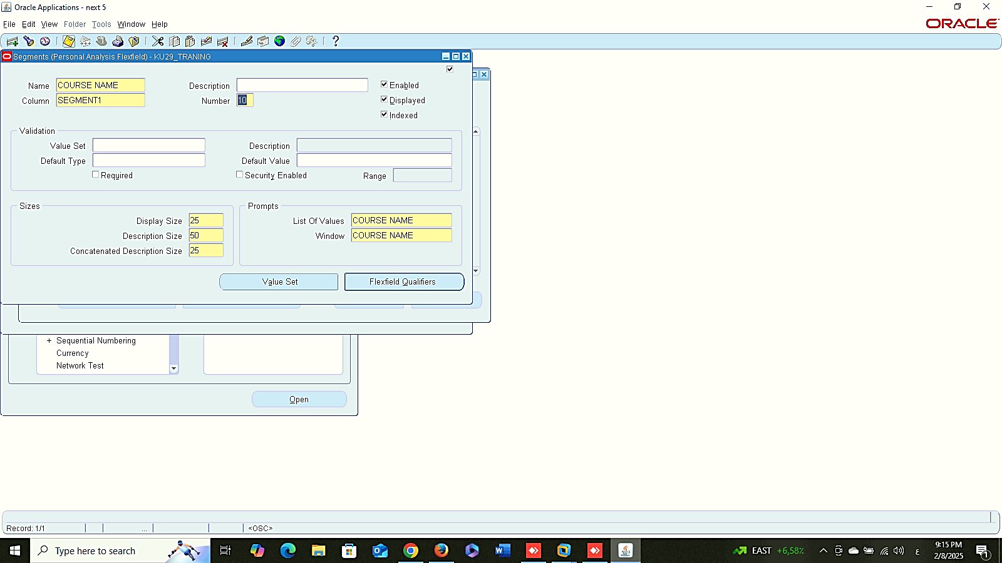
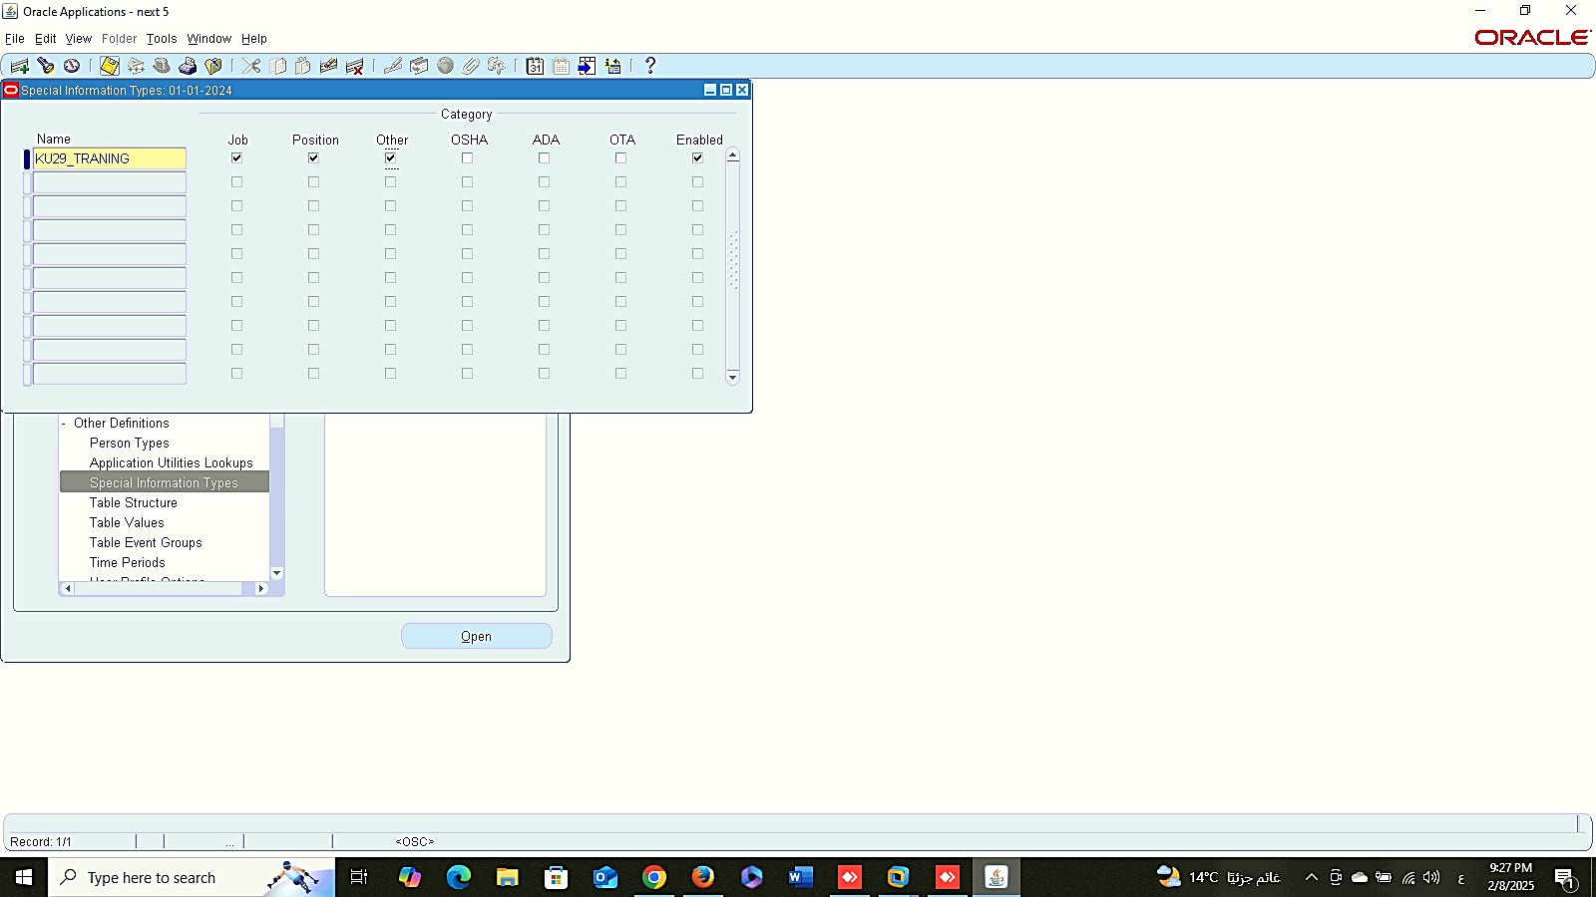
Create New Key Flex-field
Create New Key Flex-field
1
2
People
Management
Special Information Type:
1- Create New Key Flex field:
SYSTEM ADMINSTRATOR > APPLICATION > FLEXFILD > KEY > SEGEMENT
2- Information Type:
Global HRMS MANAGER > OTHER DEFINITIONS > SPECIAL INFORMATION TYPES
Create New Key Flex-field
Information Type
3

Slide 30
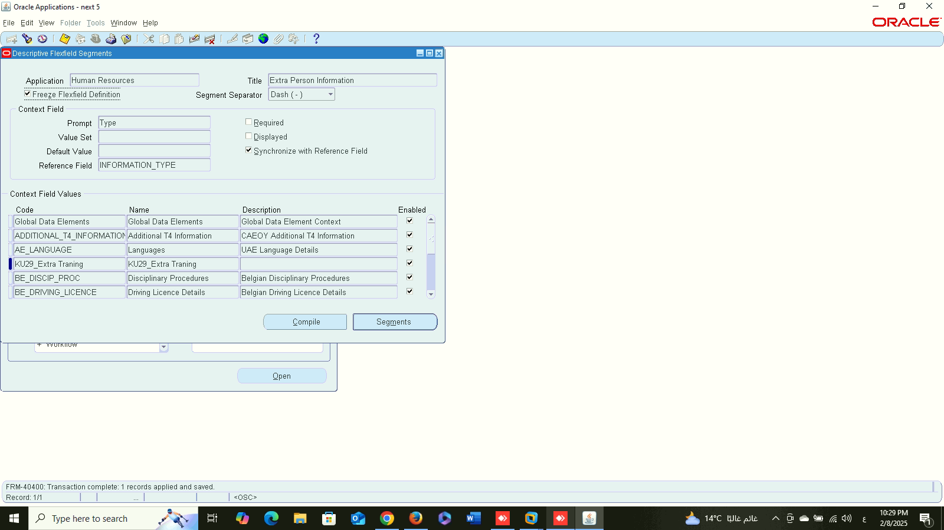

1
People
Management
Extra Person Information Type:
1- Create Descriptive Flex-field :
SYSTEM ADMINSTRATOR > APPLICATION > FLEXFILD > DESCRIPTIVE > SEGEMENT
2

Slide 31
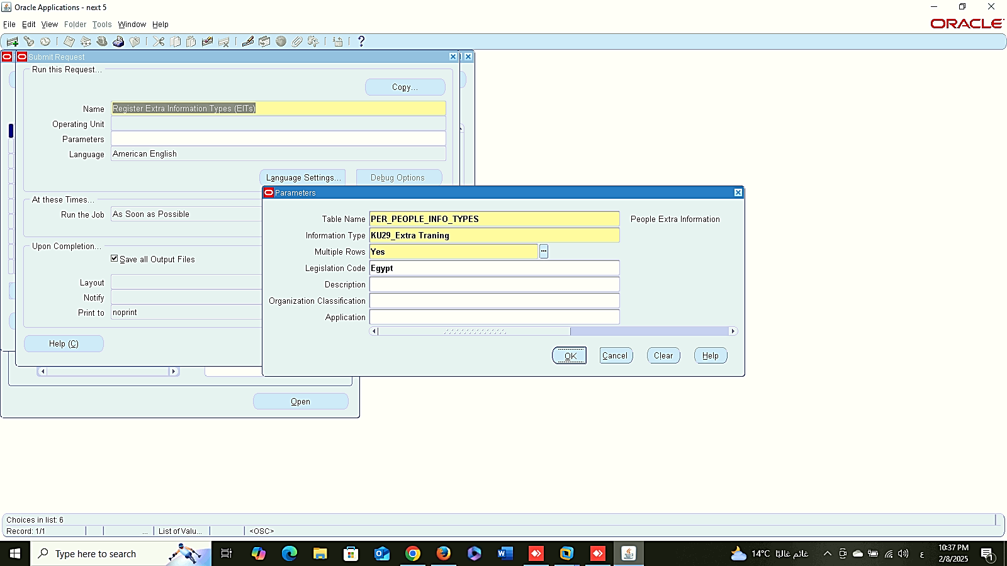


1
People
Management
Extra Person Information Type:
2- Requests :
GLOBAL HRMS MANAGER> VIEW > REQUESTS > SUBMIT A NEW REQUEST
2
3

Slide 32



Assign to Responsibility
People
Management
Extra Person Information Type:
3- Assign to Responsibility :
GLOBAL HRMS MANAGER> SECURITY > INFORMATION TYPE SECURITY
4- Extra Person Information:
GLOBAL HRMS MANAGER> PEOPLE > ENTER AND MAINTAIN > FIND > OTHER
Extra Information
1
2

Slide 33


End Employment
1
People
Management
End Employment :
Global HRMS MANAGER > PEOPLE > ENTER AND MAINTAIN > FIND > OTHER
2

Slide 34



Assignment
A
B
People
Management
View Lists:
1- Assignment
A. Global HRMS MANAGER > VIEW > LISTS > PEOPLE BY ASSIGNMENT
B. Global HRMS MANAGER > VIEW > LISTS > ASSIGNMENT
2- Position
Global HRMS MANAGER > VIEW > LISTS > WORKFORCE BY POSITION
3- Element
Global HRMS MANAGER > VIEW > LISTS > EMPLOYEE BY ELEMENT
Position
Element

Slide 35


Special Information
People
Management
View Lists:
4- Special Information
Global HRMS MANAGER > VIEW > LISTS > PEOPLE BY SPECIAL INFORMATION
Date Track
Global HRMS MANAGER > PEOPLE > ENTER AND MAINTAIN > FIND > ASSIGNMENT
Date Track

Slide 36




1
2
People
Management
Run Reports:
Global HRMS MANAGER > VIEW > REQUESTS > SUBMIT A NEW REQUIST
3
4

Slide 37




5
6
People
Management
Run Reports:
Global HRMS MANAGER > VIEW > REQUESTS > SUBMIT A NEW REQUIST
7
8

Slide 38


View Output
People
Management
View:
View Output:
View Log
View Log

